Slide 1
LITERATURE REVIEW
4 Articles Reviews
ML & Indoor Building Environments
Searching for research gaps| Week 2

Slide 2
ARTICLE #1
A machine learning approach to predict healthcare associated infections at intensive care unit admission: findings from the SPIN-UTI project
Barchitta et al., 2021, Journal of Hospital Infection
SUMMARY
This study looked at whether a machine learning model could better predict which ICU patients are likely to get a hospital-acquired infection (HAI), compared to using a standard scoring system (SAPS II) alone. They used data from over 7,800 ICU patients across Italy and found that their ML model was significantly more accurate.
INTENTION / RESEARCH QUESTION
Can machine learning predict which ICU patients will develop a healthcare-associated infection, using information available right at the time of admission?

Slide 3
ARTICLE #1
DATASET
Italian SPIN-UTI project, 7,827 patients, multiple ICUs across Italy, 2006–2019
Variables: sex, patient origin, coronary disease treatment, surgical intervention, SAPS II score, invasive devices (urinary catheter, intubation, central venous catheter), trauma, impaired immunity, antibiotic use 48h before admission.
Predicted: whether a patient developed at least one HAI (health associated infection) during ICU stay (yes/no).
RESULTS
SAPS II alone: AUC 0.61, accuracy 56%.
SVM with all features including SAPS II: AUC 0.90, accuracy 88%.
SVM without SAPS II: AUC 0.66, accuracy 78%.
NOTES
Incorporating conventionally used SAPS II (something like PMV in thermal comfort) significantly boosted accuracy of the model from 78% to 88%.
MODELS USED
SVM with Gaussian/RBF kernel. Training data were class-imbalanced (far more non-infected patients), so SMOTE was used to generate synthetic infected-patient records for training only. Final testing was on real data only.
GAP / LIMITATION
~60% of records excluded due to missing values in one or more input variables — complete data required for all features. Risk of selection bias. Model is a "black box" — no visibility into why a prediction is made. Only tested on Italian data, generalizability unclear.

Slide 4
ARTICLE #2
Supervised machine learning for the prediction of infection on admission to hospital: a prospective observational cohort study
[Rawson et al., 2019, Journal of Antimicrobial Chemotherapy
SUMMARY
This study tested whether an SVM-based algorithm could diagnose bacterial infection in patients arriving at hospital, using only routine blood test results available at admission — without relying on clinical judgement or microbiological cultures. The algorithm performed well (AUC 0.84), suggesting it could support clinicians in identifying infected patients earlier and more consistently, potentially reducing unnecessary antibiotic use and improving microbiological sampling before treatment starts.
INTENTION / RESEARCH QUESTION
Can a supervised machine learning algorithm predict bacterial infection at hospital admission using a small set of routine blood parameters?

Slide 5
ARTICLE #2
DATASET
Imperial College Healthcare NHS Trust, London. Training: 160,203 patient profiles with microbiology and blood test data from 2009–2015. Prospective test cohort: 104 patients admitted over 6 months (Oct 2017–Mar 2018).
Variables: CRP, white cell count, bilirubin, creatinine, ALT, alkaline phosphatase.
Predicted: whether a patient had a community-acquired bacterial infection within 72h of admission (yes/no).
RESULTS
ROC AUC 0.84.
Mean infection likelihood: 0.80 (infected) vs 0.50 (non-infected). At cut-off 0.812: sensitivity 89%, specificity 63%.
At cut-off 0.820: sensitivity 44%, specificity 93%.
NOTES
MODELS USED
SVM binary classifier embedded in a clinical decision support system (EPIC IMPOC). Training data had class imbalance (far more non-infected profiles), addressed using SMOTE. System required at least 4 of 6 blood parameters to function.
GAP / LIMITATION
Tested only on 104 patients. Single hospital network in West London, so generalizability is unclear. Lactate and physiological parameters (heart rate, blood pressure etc.) were not electronically available and couldn't be included, despite being clinically relevant.

Slide 6
ARTICLE #3
Supervised machine learning for the prediction of infection on admission to hospital: a prospective observational cohort study
Rawson et al., 2019, Journal of Antimicrobial Chemotherapy
SUMMARY
This study developed an ML-based clinical decision support tool to predict healthcare-associated infections (HAI) before symptoms appear, using routine hospital data from over 290,000 patients across 450+ US hospitals. The model was able to detect infection risk up to 48h before clinical suspicion, outperforming established clinical scoring systems like qSOFA. The study also analyzed which clinical features contributed most to predictions, making the model more interpretable for clinical use.
INTENTION / RESEARCH QUESTION
Can a machine learning model predict HAI before clinical suspicion arises, using routinely collected vital signs, lab results and demographics?

Slide 7
ARTICLE #3
DATASET
Three combined US hospital datasets: MIMIC-III, eICU, and Banner Health. 293,109 patients total (36,782 HAI, 256,327 controls), from 450+ hospitals, 2001–2016.
Variables: demographics (age, gender, height, weight), vital signs (heart rate, blood pressure, temperature, SpO2, respiration), and laboratory measurements (163 total — metabolic panels, blood count, blood gas, etc.).
Predicted: whether a patient would develop a HAI, up to 48h before clinical suspicion (defined as ordering a microbiology test or starting antibiotics).
RESULTS
Best model (XGBoost, 163 features): AUC 0.88 at 1h before clinical suspicion, AUC >0.85 maintained up to 48h before suspicion.
Reduced model (36 most common features): AUC 0.86 — still strong with half the variables.
Vitals-only model (no lab tests): AUC 0.81.
Compared to single temperature: AUC 0.59. Compared to qSOFA score: AUC 0.59.
Model performed best for sepsis (recall 0.70) and bloodstream infection (recall 0.67), worst for urinary infections (recall 0.46).
Top predictive features: albumin, SpO2, lactate, temperature, WBC.
MODELS USED
Ensemble-based boosted decision trees — primarily XGBoost (gradient boosting) and AdaBoost. Also tested logistic regression as a baseline. Stratified 5-fold cross-validation. Class imbalance addressed by downsampling the control group to maintain 12.5% infection prevalence. Feature importance analyzed using SHAP values.
GAP / LIMITATION
All data retrospective — model not tested in real clinical practice. Data from before ICD-10 adoption, so infection labels based on older, less specific ICD-9 codes. Exact timing of clinical suspicion hard to determine precisely. Patients with comorbidities (e.g. fluid disorders, cancer, anemia) had higher false positive rates.

Slide 8
ARTICLE #4
Prediction of risk of acquiring urinary tract infection during hospital stay based on machine-learning: A retrospective cohort study
Møller et al., 2021, PLOS ONE
SUMMARY
This study developed two ML models to predict which patients are at risk of developing a urinary tract infection (UTI) during hospital stay — one at the moment of admission, one after 48h. Data came from ~300,000 admissions in southern Denmark. Both models performed well and the authors believe they can serve as real-time early warning systems for clinical staff. Decision Trees were chosen as the preferred model type due to their transparency and ease of clinical interpretation.
INTENTION / RESEARCH QUESTION
Can ML models predict which patients will develop a UTI during hospital stay — both at admission (Entry Model) and after 48h (HA-UTI Model)?

Slide 9
ARTICLE #4
DATASET
Region of Southern Denmark, 301,932 adult admissions across 4 hospital trusts, January 2017 – May 2018.
Variables: demographics (age, sex), admission type, readmission status, ICD-10 diagnosis codes (diabetes, urinary retention, kidney disease, stroke, hypertension, COPD, etc.), previous UTIs, previous indwelling urinary catheter (IUC), antibiotic treatment. HA-UTI model additionally used observational data extracted via text mining from clinical notes (fever, dysuria, frequency, urgency, suprapubic tenderness, IUC during admission).
Predicted: Entry Model — any UTI (CA-UTI or HA-UTI) at admission. HA-UTI Model — hospital-acquired UTI developing after 48h of admission.
RESULTS
Entry Model (AUC): 0.81–0.84 across all five algorithms — no major differences between them (ANN were the best, but not transparent → decision tree used at the end).
HA-UTI Model (AUC): 0.71–0.77 — lower, as expected (predicting further into the future is harder).
Top predictive features: age, previous CA-UTI, admission type, sex, previous HA-UTI.
Cumulative lift: among the top 10% highest-risk patients, the model found 4x more UTI cases than random selection. Preliminary pilot: 72% of patients who developed HA-UTI had a risk score ≥0.15 at admission.
MODELS USED
Five algorithms compared: Decision Tree, Decision Tree 3-Way Split, Gradient Boosting, Neural Network, Regression. Decision Tree selected as champion model for its transparency. Text mining (NLP) used to extract clinical triggers from unstructured EMR notes. No imputation needed — very few missing values.
GAP / LIMITATION
All data retrospective — model not tested in real clinical practice. Data from before ICD-10 adoption, so infection labels based on older, less specific ICD-9 codes. Exact timing of clinical suspicion hard to determine precisely. Patients with comorbidities (e.g. fluid disorders, cancer, anemia) had higher false positive rates.

Slide 10
ARTICLE TEMPLATE
[Article Title]
[Authors, Year, Journal]
SUMMARY
[Overview of the paper]
INTENTION / RESEARCH QUESTION
[What did they try to find out or improve?]

Slide 11
ARTICLE TEMPLATE
DATASET
[Source, size, parameters, time span]
RESULTS
[Key metrics: RMSE, AUC, Accuracy, R², ...]
MODELS USED
[ML methods, architectures, training approach]
NOTES
[My notes]
GAP / LIMITATION
[What's missing? What could be improved? What wasn't addressed?]

Slide 12
LITERATURE REVIEW
Systematic reviews
ML & Indoor Building Environments
Searching for research gaps| Week 2

Slide 13
SYSTEMATIC REVIEWS USED FOR GAP MAPPING
Review list
AI-Based Modeling of Indoor Air Quality and Thermal Comfort: A Systematic Review of Human-Centric and Adaptive Approaches
Aziz, N.A.; Razak, T.R.; Nordin, S.; Jarimi, H.; Su, Y.; Riffat, S. - 2025 - Journal of Climate Change
2. Quantifying airborne transmission in ventilated settings: A review Giri et al. - 2024 - Building and Environment
3. Systematic review on uncertainty quantification in machine learning-based building energy modeling
Xu et al. - 2025 - Building and Environment
4. Review on uncertainty quantification in ML-based building energy modeling 2024 review on UQ in ML-based BEM; the current slide in the deck appears to have a title mismatch.
5. Machine Learning and Deep Learning Methods for Enhancing Building Energy Efficiency and Indoor Environmental Quality - A Review Tien et al. - 2022 - Energy and AI
6. Physics-informed machine learning for building performance simulation - A review of a nascent field Jiang et al. - 2025 - Advances in Applied Energy
7. Machine Learning for Energy Management in Buildings: A Systematic Review on Real-World Applications Aziz et al. - 2025 - Journal of Climate Change
8. Predicting and Enhancing Indoor Environmental Quality in Educational Environments: Latest Trends in AI and Machine Learning Applications Baru et al. - 2025 - CIB Conferences
9. A Systematic Review on the Use of AI for Energy Efficiency and Indoor Environmental Quality in Buildings
Ogundiran et al., 2024, Sustainability, Vol. 16, Article 3627

Slide 14
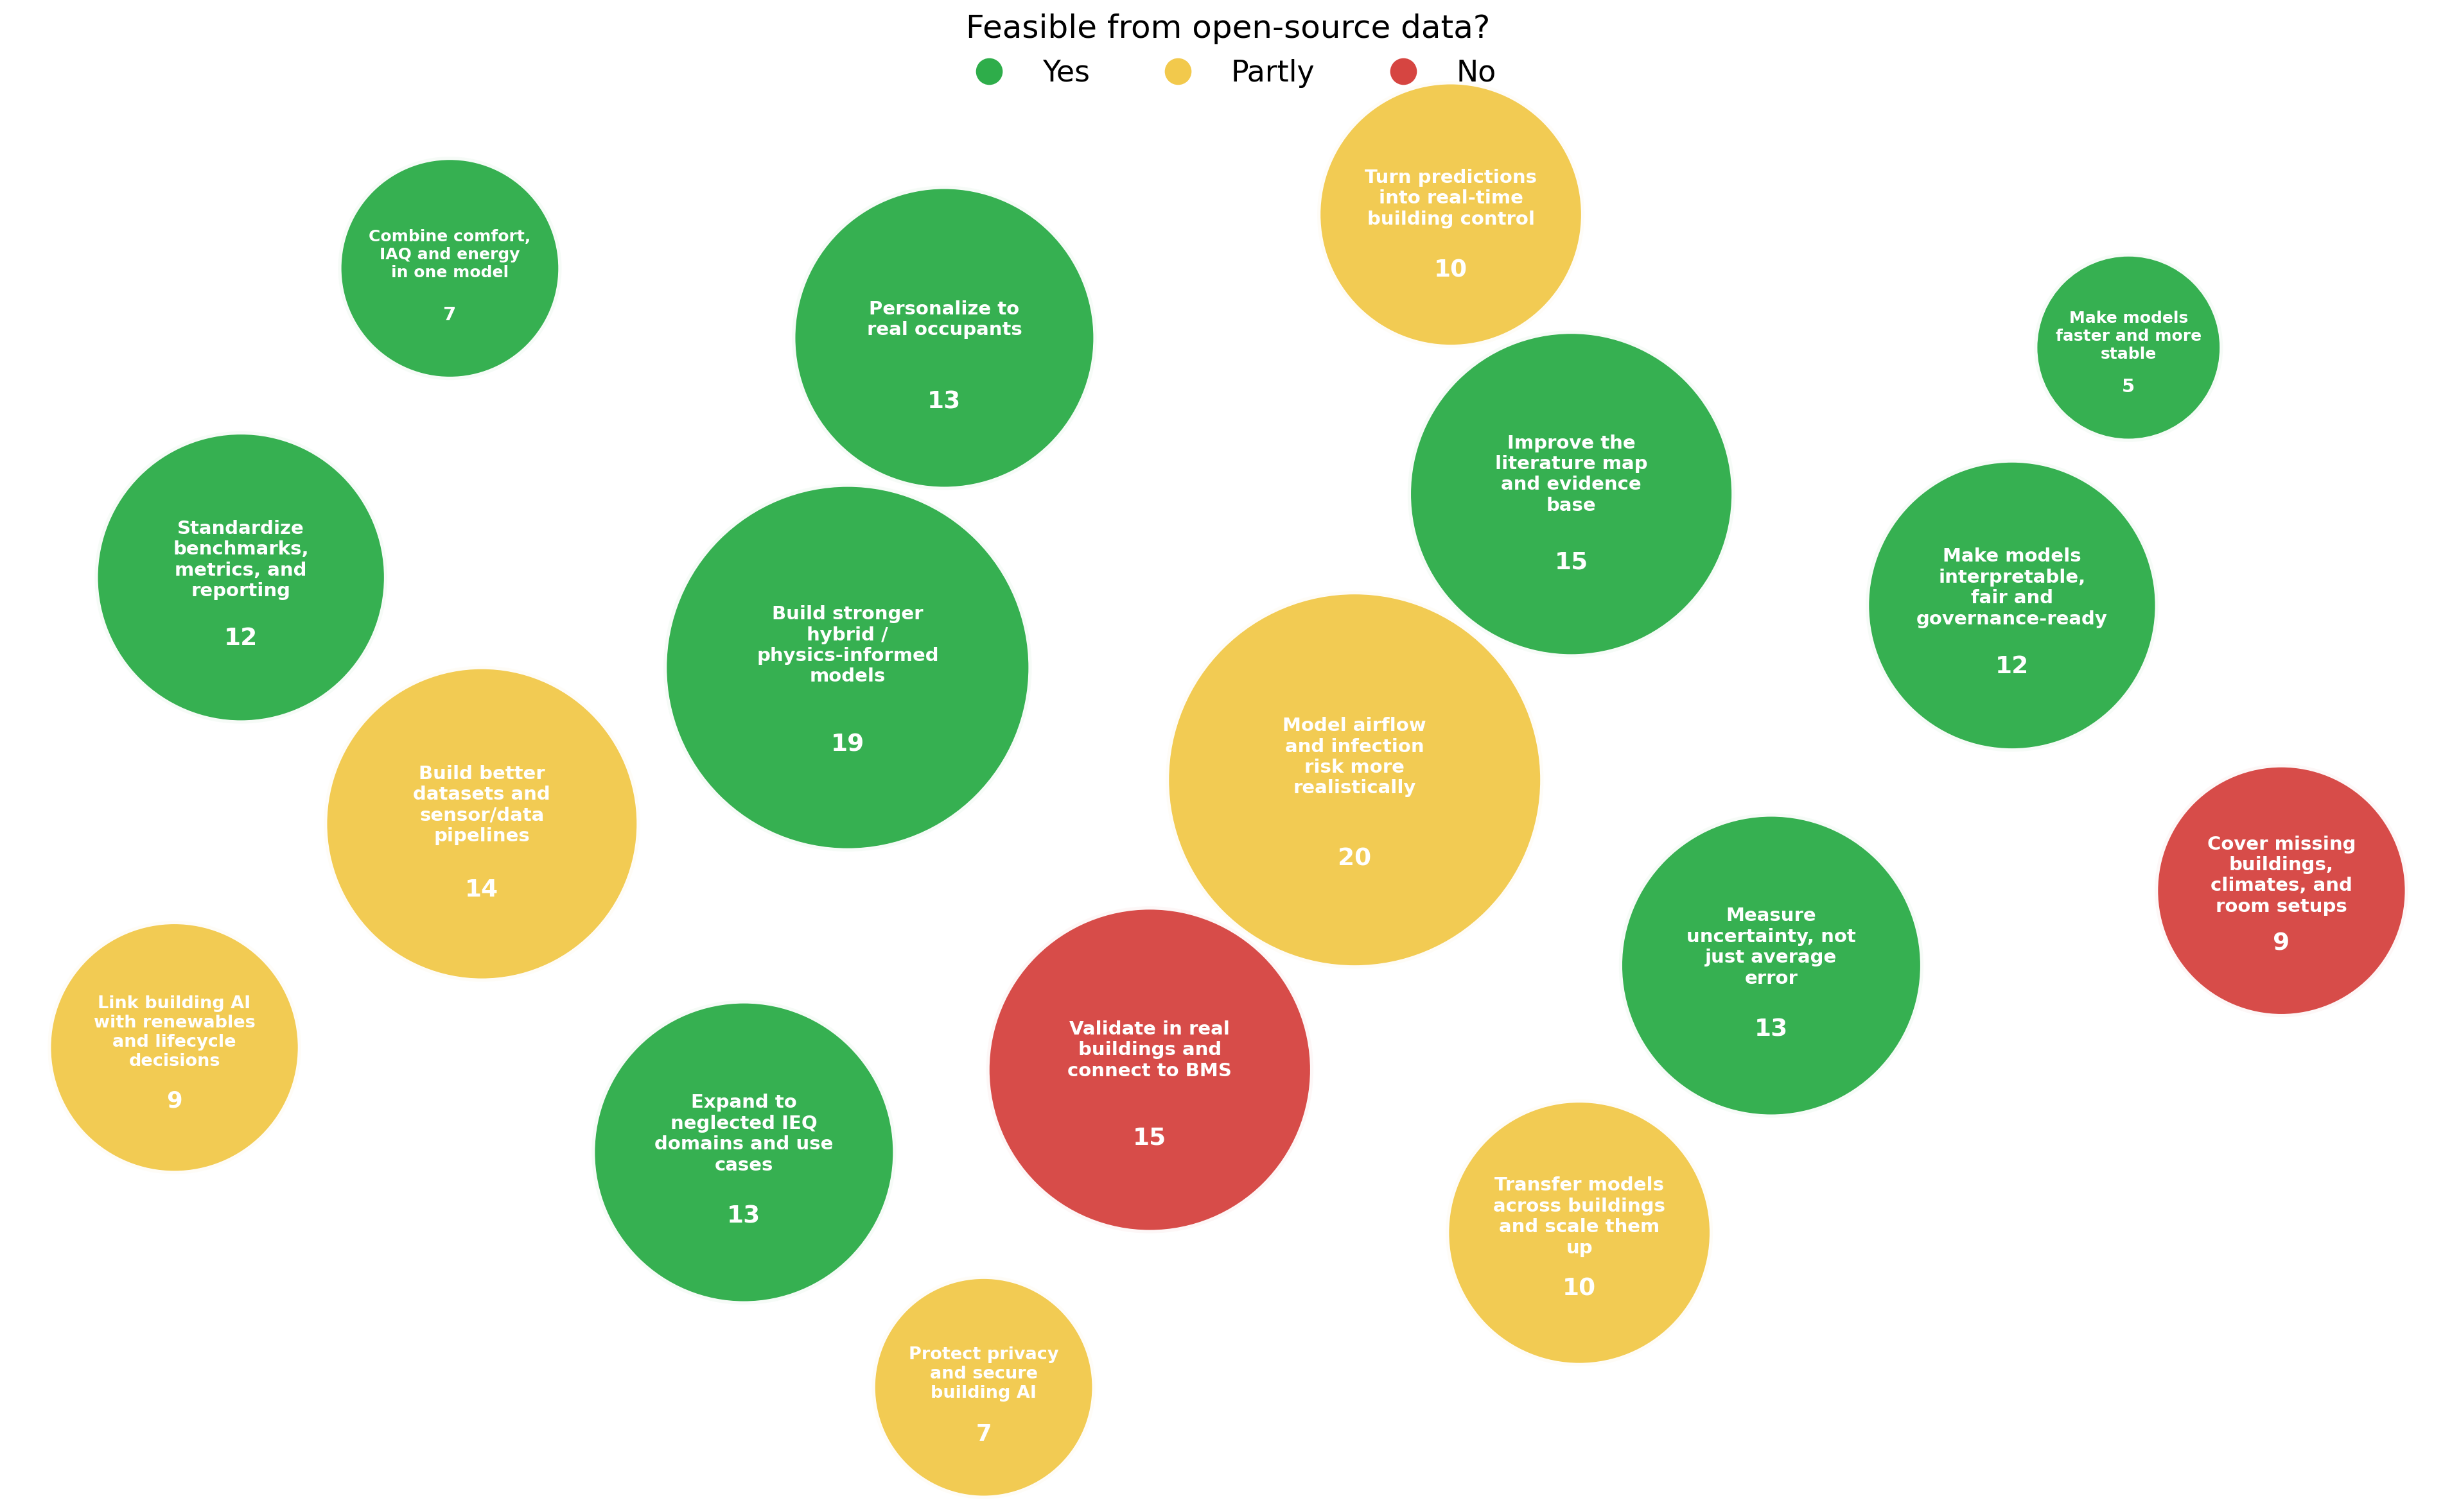
Research gaps identified by reviews

Slide 15
REVIEW TEMPLATE
[Article Title]
[Authors, Year, Journal]
SUMMARY
[Overview of the paper]
INTENTION / RESEARCH QUESTION
[What did they try to find out or improve?]

Slide 16
REVIEW TEMPLATE
SCOPE
[Source, size, parameters, time span]
TAXONOMY / METHODS COVERED
[ML methods, architectures, training approach]
RESULTS
[Key metrics: RMSE, AUC, Accuracy, R², ...]
RESEARCH GAPS
[Oportunities for future research]

Slide 17
REVIEW #1
AI-Based Modeling of Indoor Air Quality and Thermal Comfort: A Systematic Review of Human-Centric and Adaptive Approaches
Aziz, N.A., Razak, T.R., Nordin, S., Jarimi, H., Su, Y., & Riffat, S. (2025). Journal of Climate Change, 11(4), pp. 505–533. https://doi.org/10.70917/jcc-2025-034
SUMMARY
A systematic review of 72 peer-reviewed studies (2020–2024) examining AI and soft computing methods applied to Indoor Air Quality (IAQ) and thermal comfort modeling in buildings. Post-pandemic context drove increased interest in health-focused, data-driven indoor environment management. The review finds that while AI methods have matured significantly, most approaches remain siloed, opaque, and simulation-only, with little real-world validation or occupant-centric design.
INTENTION / RESEARCH QUESTION
What environmental and human-centered parameters are typically modeled?
Which AI and soft computing techniques dominate the field?
To what extent are IAQ and thermal comfort addressed in unified frameworks?
How is personalization and occupant feedback incorporated?

Slide 18
REVIEW #1
SCOPE
Period: January 2020 – December 2024
Databases: Scopus, Web of Science, IEEE Xplore
Initial records: 420 → final included: 72
Criteria: peer-reviewed, empirical, AI/ML applied to IAQ and/or thermal comfort in indoor built environments, English only
TAXONOMY / METHODS COVERED
AI techniques: CNN, LSTM, ANN, SVM, XGBoost, Random Forest, Fuzzy Logic, MPC, Reinforcement Learning, hybrid architectures
Environmental parameters: CO₂, PM2.5, VOCs, temperature, humidity, air velocity
Study types: field study, simulation, experimental testbed, survey
Human-centric features: thermal sensation votes, wearable sensors, occupant feedback, adaptive thresholds
KEY FINDINGS
CNN most frequently used technique (16 studies), followed by Fuzzy Logic (14) and LSTM (10)
23 studies focused on IAQ prediction, 31 on thermal comfort — mostly independently
Only 9 of 72 studies addressed IAQ and thermal comfort jointly; only 8 included all three dimensions (IAQ + thermal comfort + human-centric modeling)
Fewer than 15% of studies incorporated real-time occupant feedback or personalized control
Trend toward hybrid models (CNN-LSTM, FL-CNN-LSTM) growing but still mostly simulation-based
Earlier studies (2020–2021) relied on black-box models with no field validation; more recent work begins integrating multi-modal sensor data

Slide 19
REVIEW #1
FUTURE RESEARCH DIRECTIONS & OPEN PROBLEMS
Build unified multi-objective frameworks that jointly optimize IAQ, thermal comfort, and energy consumption — current siloed approaches miss critical trade-offs (e.g. increasing ventilation improves IAQ but raises energy use and disrupts thermal comfort)
Develop hybrid XAI models combining deep learning accuracy with interpretable methods (fuzzy logic, SHAP, LIME) to enable regulatory compliance and stakeholder trust
Incorporate real-time occupant feedback, user profiling, and behavioral adaptation into AI control systems — most models currently treat occupants as static and homogeneous
Account for inter-individual variability in comfort perception — age, health status, culture, circadian rhythms are almost never modeled
Deploy and validate models in real operational buildings across diverse climates and building types, not just simulation environments
Integrate energy performance metrics as a third optimization variable alongside IAQ and thermal comfort
Test AI model interoperability with existing Building Management Systems (BMS) for practical deployment
Focus research on high-risk, high-occupancy environments — schools, hospitals, and social housing are severely underrepresented despite being most affected by poor indoor environmental quality
Explore reinforcement learning and MCDM for personalized comfort optimization — currently mostly conceptual

Slide 20
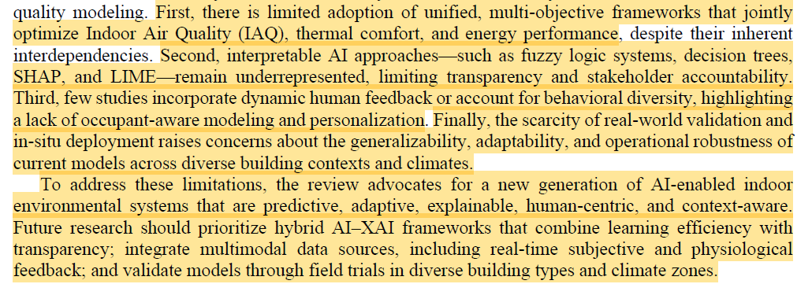
REVIEW #1
MY NOTES

Slide 21
REVIEW #2
Quantifying airborne transmission in ventilated settings: A review
Giri et al., 2024, Building and Environment, Volume 266, 112049
SUMMARY
This systematic review examines 76 studies on airborne pathogen transmission in ventilated indoor environments. It categorise findings into indoor airflow patterns, dynamics of infectious respiratory particles (IRPs), and experimental/numerical methods. About 40% of studies do not specify an indoor setting; only 3% address restaurants. Most studies assume constant air conditions and focus on coughing and breathing. The review recommends shifting attention to social settings, varying air conditions, speech-related flows, and high-fidelity simulation tools.
INTENTION / RESEARCH QUESTION
How do ventilation regimes, indoor air conditions, and respiratory activities affect the transport and exposure risk of airborne infectious respiratory particles indoors—and where are the gaps in current research?

Slide 22
REVIEW #2
SCOPE
Studies included: 76 research papers (from 385 unique records; 50 from initial screening + 26 from 13 relevant review papers containing 2,046 references)
Selection criteria: Must investigate airborne IRP transmission in ventilated indoor settings using experiments, validated RANS, LES, or DNS.
Excluded: purely theoretical, purely epidemiological, unvalidated RANS, building-scale aerodynamics, non-English, non-accessible.
Time period: Up to 2024; ~80% published after 2020
TAXONOMY / METHODS COVERED
The review classifies the literature along three axes: (1) Indoor airflow — mixing, displacement, and stratum/cross ventilation combined with three occupant configurations (face-to-face, same-direction, healthcare lying/standing); (2) IRP dynamics — effects of temperature, humidity, and four respiratory activities (coughing, sneezing, breathing, speaking); (3) Investigation approaches — experimental methods (tracer gas, aerosol generators, manikins, PIV, PLIF) and CFD (RANS: 51 studies, LES: 21, DNS: 5) with Eulerian and Lagrangian particle transport.
KEY FINDINGS
Settings: 39% unclassified, 26% healthcare, 14% classroom, 9% office, 8% transport, 3% restaurant.
CFD approaches: 51 RANS studies (38 using k-ε), 21 LES, 5 DNS. LES shows better agreement with experimental data than RANS.
IRP production: Speaking generates 1–10,000 IRPs/s vs. coughing at 1–1,000 IRPs/s. Speaking produces IRPs from 1 µm to 1 mm.
Ventilation: Mixing ventilation is the most common regime. Higher ventilation rates remove pathogens from the room but do not necessarily reduce IRP concentration near an occupant.
Risk models: Wells-Riley model is widely used but limited by the well-mixed assumption. CFD-coupled risk models improve spatial accuracy but depend on CFD fidelity.

Slide 23
REVIEW #2
FUTURE RESEARCH DIRECTIONS & OPEN PROBLEMS
Restaurant and social settings are severely understudied. Only 3% of studies focus on restaurants despite high transmission potential in post-pandemic social gatherings.
~40% of studies use generic room geometries rather than replicating specific real-world indoor settings.
Air temperature and humidity combinations are rarely varied. Most studies assume constant indoor air conditions.
Tropical climate conditions are underrepresented despite their relevance to IRP dynamics.
Speech-related respiratory flows are understudied. Speaking produces far more IRPs than coughing but receives less attention.
Combined speaking and breathing patterns are not examined, despite being dominant in social settings.
Sneezing receives limited research attention compared to coughing and breathing.
Respiratory flow is modelled as constant, not pulsatile, though real respiratory flow varies in frequency by activity.
RANS dominates (51 studies) despite known limitations for indoor turbulent flows; it overestimates dispersion and assumes well-mixed conditions.
DNS is computationally prohibitive for most researchers (only 5 studies).
LES needs wider adoption; it agrees better with experiments than RANS but remains less common.
Eulerian RANS overestimates dispersion, leading to unrealistic well-mixed room assumptions.
Few experiments account for all three airflow sources (respiratory, ventilation, thermal) simultaneously.
Tracer gases cannot replicate two-phase IRP behaviour (volatility, deposition, size evolution).
PIV and PLIF are underutilised despite being non-intrusive and ideal for IRP studies.
Exposure risk and infection risk are conflated in many studies. They are distinct: exposure is physical transport; infection is pathogen multiplication.
Wells-Riley model assumes well-mixed conditions, a major limitation addressed only by CFD coupling.
CFD-coupled risk models depend on simulation accuracy, which varies by method.
Most studies assume perfectly still occupants. Occupant movement (walking, door opening) is rarely included.
Airflow from susceptible individuals is ignored in multi-occupant setups.
Face-to-face occupant configuration (common in restaurants) is the least studied.
Increasing ventilation rate alone does not reduce IRP concentration near occupants.
Machine learning / deep learning to accelerate CFD is absent from the reviewed studies despite being included as a search term.

Slide 24
REVIEW #3
Systematic review on uncertainty quantification in machine learning-based building energy modeling
Xu et al., 2025, Building and Environment
SUMMARY
This systematic review surveys 141 studies (2014–2024) on uncertainty quantification (UQ) in machine learning (ML)-based building energy modeling (BEM). It identifies three uncertainty sources: building system operations, simulation tools, and ML models. Ten UQ techniques are reviewed for deterministic and stochastic ML-based BEM. Gaussian Processes (28%), MCMC (23%), and ensemble methods (15%) dominate the field. The review finds that aleatoric uncertainty is underrepresented and advanced UQ methods like BBB, PNs, and BAL remain unexplored in BEM.
INTENTION / RESEARCH QUESTION
Why is UQ necessary in ML-based BEM?
How to apply UQ systematically?
What are the advantages/disadvantages of UQ techniques?
What are current challenges?

Slide 25
REVIEW #3
SCOPE
Studies included: 141 (from 750 initial, filtered through scoping → 582 → 221 → 141)
Selection criteria: Peer-reviewed, English, published 2014–2024, citation threshold ≥ 3, must include uncertainty analysis
Time period: 2014–2024
TAXONOMY / METHODS COVERED
Uncertainty sources: Building system operations (environmental, human-related, data collection, system parameters); Building simulation tools (simulation simplification, numerical approximation); ML models (feature selection, optimization algorithms, hyperparameter tuning, irreducible model discrepancy).
UQ techniques for deterministic ML models: Ensemble modeling, Prior Networks (PNs).
UQ techniques for stochastic ML models: BNNs, MCMC (MH, Gibbs, HMC, NUTS, SG-MCMC), Variational Inference, Dropout Networks (VID, MCD, Concrete, Adaptive), Bayes by Backprop, Bayesian Active Learning, VAEs, Gaussian Processes.
KEY FINDINGS
GPs: 28% of reviewed studies. Favored for modeling uncertainty through distributions over functions.
MCMC: 23%. Widely used for Bayesian calibration and sampling from complex posteriors.
Ensemble: 15%. Leverages multiple independent models to measure predictive variability.
BNNs: 9%. Explicit Bayesian uncertainty modeling.
Dropout Networks: 7%. Simple and efficient epistemic UQ.
VI: 7%. Efficient alternative to MCMC.VAEs: 6%. Used mainly for data augmentation; uncertainty in reconstructed data often neglected.
BBB: <1%. Underexplored; requires extensive hyperparameter tuning.
Publication peak: 21 eligible papers in 2023.Methodological shift: GP/MCMC dominance (2014–2018) declining in favor of ensemble, VI, BNNs.

Slide 26
REVIEW #3
FUTURE RESEARCH DIRECTIONS & OPEN PROBLEMS
Aleatoric uncertainty is underrepresented in building datasets and ML-based BEM research. Most studies focus on epistemic uncertainty.
No systematic framework decomposes total uncertainty into reducible and irreducible components at the data collection stage.
ML models operate as black boxes. Limited interpretability prevents tracing uncertainty sources and distinguishing aleatoric from epistemic components.
Feature importance analysis, L1/L2 regularization, and dimensionality reduction are underused for improving transparency.
Studies overemphasize accuracy metrics (RMSE, MAE) over uncertainty metrics (PICP, CRPS).
Structured uncertainty metrics like PICP and CRPS are underutilized. Many studies rely on boxplots and simple mean/variance.
Trade-off between approximation accuracy and computational cost is unresolved for large-scale BEM.
MCMC and GPs have poor scalability to large or time-series building datasets.
Prior Networks have not been applied to ML-based BEM.
BBB remains underexplored. Only one study applied it, finding impractical hyperparameter tuning demands.
Bayesian Active Learning has not been applied to ML-based BEM despite its data scalability potential.
Deep Gaussian Processes have not been applied to BEM despite their promise for scalability.
Ensemble methods rely on subjective base model selection rather than structured criteria with cross-validation.
Gradient-based MCMC methods (HMC, NUTS) are underadopted despite better scalability in high-dimensional spaces.
Most VAE-based BEM studies focus on data augmentation and neglect uncertainty in reconstructed data.
Most dropout studies use fixed rates despite non-stationary building data. Adaptive dropout is underexplored.
Data uncertainty from sensors and simulation simplifications is underexplored, undermining reliability.
No established paradigm balances prediction accuracy and uncertainty in model selection and validation.
Limited guidance exists on prior distribution selection for Bayesian BEM applications.
A holistic evaluation paradigm combining accuracy and uncertainty is needed for real-time control and smart grid deployment.

Slide 27
REVIEW #4
Machine Learning and Deep Learning Methods for Enhancing Building Energy Efficiency and Indoor Environmental Quality – A Review
Tien et al., 2022, Energy and AI (Volume 10, 100198)
SUMMARY
This review covers ML and DL methods applied to building energy efficiency and indoor environmental quality over the past decade. It reviewed 171 articles (from 362 initially identified) across energy forecasting, HVAC management, thermal comfort, IAQ, occupancy detection, and fault detection. ML/DL methods outperform conventional approaches (e.g., BES, PMV) in most tasks. Most studies remain at the experimental stage with limited real-building deployment. Few studies address energy, thermal comfort, and air quality together.
INTENTION / RESEARCH QUESTION
What ML and DL techniques have been applied to building energy efficiency and indoor environmental quality, what are their frameworks, methodologies, and performance levels, and what gaps and challenges remain?

Slide 28
REVIEW #4
SCOPE
articles included (from 362 initial records), PRISMA-based selection
Time period: past decade (~2011–2022, with exceptions)
Scope: supervised/unsupervised ML, deep learning for HVAC, energy, thermal comfort, IAQ, occupancy, fault detection
TAXONOMY / METHODS COVERED
Supervised ML: SVM/SVR, Random Forest, KNN, Decision Trees, Linear/Multivariate Regression, Ensemble Methods, ELM, ANN
Unsupervised ML: K-Means, Fuzzy C-Means, Hierarchical Clustering, Gaussian Mixture Models, HMM
Deep Learning: CNN, RNN, LSTM, GRU, DNN, CNN-LSTM hybrids, Faster R-CNN, Transfer Learning, Deep Belief Networks, Autoencoders, DRNN
Reinforcement Learning: Deep reinforcement learning for HVAC control
KEY FINDINGS
Energy prediction: AI models reduced simulation time from 1145s to 0.9s vs BES with comparable accuracy. ELM achieved MAE of 0.0348 kW for cooling load with prediction time <0.5s. Random Forest outperformed M5P and Random Tree by 49% in MAE.
Occupancy detection: WiFi-based methods achieved 80.9–93.9% accuracy. Deep learning camera-based detection reached 95.3% accuracy. Activity recognition with deep learning reached 97.6%.Thermal comfort: ML outperformed PMV by up to 17.8%. KNN-based model achieved 88.31% accuracy. Energy savings of 7–58.5% achieved via ML-based demand-driven controls.
IAQ: Deep reinforcement learning achieved 43% energy savings while reducing CO2 by 24%. ANN predicted CO2 with RMSE of 0.8816. GRU achieved 84.5% accuracy for IAQ prediction.
Fault detection: DRNN outperformed Random Forest and gradient boosting. Deep belief network achieved 97.7% fault diagnosis correct rate.

Slide 29
REVIEW #4
FUTURE RESEARCH DIRECTIONS & OPEN PROBLEMS
Most studies remain at experimental/testing stage; few deploy ML/DL in actual buildings.
Limited validation using real post-occupancy or post-completion energy data.
Few studies address energy, thermal comfort, and IAQ simultaneously — a holistic approach is lacking.
IAQ receives less attention than energy and thermal comfort.
No standardied evaluation protocol for ML/DL models in the built environment.
Wide range of evaluation metrics makes cross-study comparison difficult.
Hundreds of ML algorithms applied — no clear guidance on optimal algorithm selection for specific tasks.
Computational efficiency, data requirements, and model complexity rarely assessed.
Most studies focus on individual buildings; limited large-scale or urban-scale deployment.
Limited application in industrial and retail buildings.
Data acquisition constraints limit wider implementation.
Data pre-processing challenges and uncertainty not discussed enough.
AI-based models cannot be used at the design stage (reliance on historical data) and cannot extrapolate after design/operation changes.
Vision-based occupancy detection rarely integrated with HVAC control systems; impact on energy/comfort not well studied.
Privacy and security concerns for camera-based methods unresolved.
Detection robustness issues: indoor lighting, camera angle, overlapping objects affect performance.
Energy prediction mostly covers heating/cooling — lighting, plug loads, dehumidification underexplored.
Most studies focus on mechanical HVAC; natural ventilation and passive strategies underexplored.
Daylighting, visual comfort, and acoustics receive little attention in IEQ studies.
DL applications for IAQ and fault detection are still emerging.
Transfer learning for scaling ML/DL across buildings is underexplored but promising.
More work needed on integration with building management systems.
Weather forecast precision impacts energy prediction but is not always accounted for.
Model developers need combined AI and building engineering knowledge.

Slide 30
REVIEW #5
Physics-informed machine learning for building performance simulation — A review of a nascent field
Jiang et al., 2025, Advances in Applied Energy, Vol. 18, Article 100223
SUMMARY
This review defines and categorizes physics-informed machine learning (PIML) as a hybrid framework that merges physical laws with data-driven models for building performance simulation (BPS). It surveys 50 selected papers published between 2010 and 2025, covering five application domains: IEQ assessment, control and system optimization, airflow simulation, BTM DERs integration, and energy prediction. PIML outperforms purely data-driven models on physical consistency and generalization, but adds model complexity and training cost. The review provides a three-step model selection guideline, catalogs open datasets and testbeds, and identifies eight future research directions.
INTENTION / RESEARCH QUESTION
1. How should PIML be defined and categorized for BPS?
2. What methodologies are used to integrate physics into ML models?
3. How does PIML compare to traditional physics-based and data-driven BPS?
4. What datasets, tools, and testbeds support PIML in BPS?
5. What are the key challenges and future directions for PIML in BPS?

Slide 31
REVIEW #5
SCOPE
included: 50 (from 219 after first-round keyword filtering)
Selection criteria: Physics + ML + building-domain relevance; English language; peer-reviewed articles and conference papers
Time period: January 2010 – April 2025
TAXONOMY / METHODS COVERED
The review organizes PIML approaches into four categories:
Physics-Informed Data Set — ensemble learning, physics-informed inputs, knowledge discovery
Physics-Informed Loss Functions — governing equation-based loss (PINNs), knowledge-guided loss, surrogate physics-based loss (RC model)
Physics-Informed Model Structures — direct-solution models, direct time-stepper models, residual time-stepper models; NN types: ANN, RNN, LSTM, GNN, CNN
Physics-Informed Hard Constraints — positive constraints, symmetry constraints, linear equality constraints, boundary constraints, governing constraints
KEY FINDINGS
Temperature prediction (single zone): PIML modular NN achieved MAE of 0.43°C, versus 0.94°C for the RC baseline model.
Multi-zone temperature: Physics-consistent NN (PCNN) reached MAE of 1.17°C, outperforming both LSTM (1.27°C) and RC baseline (1.79°C).
HVAC control via MPC: Physics-consistent models achieved energy savings of 22–49% compared to baseline controllers.
Urban wind field (airflow simulation): PIGNN-CFD ran 1–2 orders of magnitude faster than traditional CFD simulations.
Fault detection and diagnostics (AHU): Physics-guided Diagnostic Bayesian Network reached a detection rate of 95.37%.
Building load forecasting: Physics-informed DNN achieved R² of 0.87 ± 0.01 and RMSE of 102.69 ± 7.82.
BTM DERs with comfort constraints: PCNN-enabled MPC delivered 22% energy saving and 27% peak demand reduction versus baseline control.
Study distribution: IEQ assessment is the most studied category (16 of 50 papers), followed by control and system optimization (13 papers) and airflow simulation (11 papers).
PINN vs. finite element methods: PINNs have not consistently outperformed finite element solvers on PDEs, particularly for nonhomogeneous problems such as multi-layer heat transfer.

Slide 32
REVIEW #5
FUTURE RESEARCH DIRECTIONS & OPEN PROBLEMS
No standard definition or taxonomy — definitions vary across studies; the field lacks a unified framework.
Physics–data tradeoff not formalized — no systematic method to decide when PIML is needed vs. pure physics or pure data-driven models.
PINN underperformance on PDEs — PINNs have not beaten finite element methods on nonhomogeneous problems (e.g., multi-layer heat transfer with abrupt material transitions).
Multi-loss balancing unsolved — no principled approach to weight multiple physics regularization terms; requires manual hyperparameter tuning.
Unit and scale mismatch in PINNs — physical quantities in BPS differ by orders of magnitude (e.g., indoor temperature 10–40°C vs. HVAC load >10,000 W); scaling strategy unclear.
Physics constraints can degrade accuracy — constrained solution space may reduce expressiveness; some studies report lower accuracy than pure data-driven models.
Real-time control incompatible with complex PIML — nonlinear PIML models cannot be solved within short optimization windows; workarounds (PSO, DPC) increase cost.
RC model integration is circular — using a calibrated RC model as a surrogate loss contradicts the scalability goal of PIML; parallel calibration + NN training not solved.
No physics-based performance metrics — current evaluation uses MAE/MSE only; no standardized metric for physical consistency beyond sanity checks and TRV.
Model verification rarely done in the field — most studies use offline historical data; real-time validation is uncommon; behavior under extreme events (heat waves, outages) mostly untested.
Limited coverage of stochastic/aleatory uncertainty — PIML reduces epistemic uncertainty but does not address occupant behavior variability; Bayesian PIML approaches unexplored in BPS.
No modular multi-domain PIML framework — airflow and thermal models are not coupled; plug-and-play integration across domains is absent.
Emerging applications understudied — renewable energy integration, smart grid, indoor farming, and urban-scale simulation are not addressed by current PIML work in BPS.
PIML + foundation models unexplored — embedding PIML into LLMs or other foundation models for BPS-specific tasks has not been demonstrated.
Knowledge discovery loop not closed — symbolic/sparse regression insights are not fed back to update embedded physics priors; no bidirectional framework exists.
Advanced architectures not fully explored — hybrid GNN + RNN structures for simultaneous spatial and temporal modeling are proposed but not implemented at scale.
Standardized benchmarks absent — datasets, metrics, HVAC configurations, and evaluation protocols differ across studies; FAIR-compliant BPS benchmarks do not exist.
Physics prior evaluation methods lacking — no systematic method to assess whether a given physics prior improves or degrades model performance before integration.
Airflow PIML limited to simplified geometries — most zone-scale studies use 2D, steady-state, isothermal conditions; 3D, transient, non-isothermal cases are open.
Outdoor CO₂ and multi-sensor infiltration models — current ventilation/infiltration PINNs assume uniform indoor CO₂ and ignore outdoor measurements.
Acoustic PIML confined to controlled rooms — diffuse reverberant fields and dynamic spaces not modeled; 3D volumetric methods not validated beyond studios.
Daylighting PIML nascent — only one PINN study (Labib 2025); RTE-based and diffusion-based models need wider validation.

Slide 33
REVIEW #6
Machine Learning for Energy Management in Buildings: A Systematic Review on Real-World Applications
Aziz et al., 2025 — Journal of Climate Change, Vol. 11, No. 4, pp. 505–533
SUMMARY
This review covers 73 real-world deployments of machine learning (ML) in building energy management systems (BEMS) from 2015 to 2025. It covers six ML families — MPC, ANNs, RL, FLC, metaheuristics, and hybrids — applied to HVAC, heat pumps, renewables, batteries, EV charging, hot water, and lighting. The review analyses both methodological attributes (algorithm design, data, baselines, metrics) and practical ones (building type, location, climate, duration). MPC dominates real deployments; RL is growing but limited by safety constraints. The field is maturing, with performance evaluation expanding beyond energy savings to cover comfort, feasibility, and grid interaction.
INTENTION / RESEARCH QUESTION
What does real-world ML-based building energy control look like in practice?
Which methods are used, how are they deployed, and what are their demonstrated results across building types, climates, and energy systems?

Slide 34
REVIEW #6
SCOPE
Studies included: 73 (from ~400 initial records, screened to 89, 16 excluded)
Criteria: Real building deployment (field pilot, living lab, or long-term experiment); ≥10 citations (relaxed for 2025 publications); peer-reviewed journals and conference papers; English only
Time period: January 2015 – March 2025
TAXONOMY / METHODS COVERED
The review organizes PIML approaches into four categories:
MPC (35 studies): Classical, economic, data-driven, robust, stochastic, discrete. Solvers: QP, MIQP, NLP, MILP, GA/PSO
ANN (6 studies): MLP, NARX, LSTM, CNN
RL (8 studies): FQI, DDPG, BDQ, DQN, PPO, SAC
FLC (8 studies): Mamdani, Takagi–Sugeno, fuzzy-PID
Hybrid (14 studies): MPC+ANN, MPC+PSO/GA, RL+MPC, ANN+CBR, ANN+GA
Other (3 studies): Model-free cognitive adaptive optimisation (CAO)
Energy systems covered: HVAC, GHP, RES (PV, solar thermal), ESS (batteries), DHW, EVCS, lighting
KEY FINDINGS
MPC: Energy savings 17–53% vs. RBC or PI baselines; 10–15% cost savings at campus scale; dominant in offices and academic buildings; most common solver is QP (13/35 studies)
ANN: CO₂ prediction within 5 min; temperature prediction error <0.2°C; NILM disaggregation error <12%; used mainly as forecasting/surrogate modules
RL: 12.8–39.6% cost/energy savings; limited to single-zone or small multi-zone; offline pre-training + online fine-tuning is the standard deployment pattern
FLC: 27–68% energy savings vs. on/off or PID; Mamdani type dominates (5/8 studies)
Hybrid: 17–80% energy savings depending on baseline; best results in multi-energy setups
Geography: 57% of studies in Europe, 22% in Asia, 15% in North America
Building types: Office (27), Residential (19), Academic (17), Mixed-use (3), Other (9)
Experimental duration: 48% short-term (<15 days), 34% medium-term (16 days–6 months), 18% long-term (>6 months)
Zone scale: 58% single-zone, 38% multi-zone
Control interface: 66% BMS/BAS integration, 22% IoT/Edge, 12% PLC

Slide 35
REVIEW #6
FUTURE RESEARCH DIRECTIONS & OPEN PROBLEMS
Most deployments are in academic labs and office testbeds; residential and small commercial buildings are underrepresented.
RL is almost always single-zone; no real-world multi-agent RL (MARL) studies across multiple zones or buildings.
Long-term validation (multi-season, >6 months) is rare for RL and ANN controllers.
No standardised experimental protocol or common baseline exists across studies (e.g., ASHRAE Guideline 36 used in only a few).
Cross-building transfer and automated commissioning (meta-learning, cold-start) have not been demonstrated in the field.
Digital-twin-to-field transfer pipelines (calibration, uncertainty quantification, adaptation phases) are not formalised.
Multi-building and district-scale deployments are rare; shared assets (TSS, ESS, EVCS) are not jointly optimised across buildings.
Multi-agent control frameworks (cooperative MPC, hierarchical, decentralised) remain prototype-level; no unified real-world validation exists.
Objective functions rely on weighted sums; multi-stakeholder, fairness-aware, or Pareto-based formulations are not tested in real buildings.
Human-in-the-loop integration (operator explanations, preference interfaces, trust dynamics) is minimal.
Edge–cloud architectures are not stress-tested for latency, communication failure, or cybersecurity incidents.
Privacy-preserving learning (federated learning) is mentioned but rarely deployed.
Metaheuristics (GA, PSO) are slow for real-time operation and appear mostly in hybrid day-ahead schedulers — standalone real-time use is not validated.
FLC rule bases scale poorly; no real-world FLC beyond 4 zones.
No studies cover tropical/Global South climates, cold-climate residential buildings at scale, or underserved sectors (social housing, small retail).
Performance metrics are inconsistent; energy savings, comfort, and IAQ are not always reported together, preventing cross-study comparison.
Mixed-use and large commercial buildings are underrepresented despite their energy impact.

Slide 36
REVIEW #7
Predicting and Enhancing Indoor Environmental Quality in Educational Environments: Latest Trends in AI and Machine Learning Applications
Baru et al., 2025 — CIB Conferences, Vol. 1, Article 93 (Proc. 23rd CIB World Building Congress)
SUMMARY
This systematic review covers AI and ML applications for monitoring and improving indoor environmental quality (IEQ) in university buildings. 20 articles (2021–2024) were selected via PRISMA from Scopus. Air quality is the most studied IEQ factor (35%), followed by thermal comfort (25%) and visual comfort (15%). Deep learning accounts for 56% of ML algorithms used. Acoustic comfort has no ML coverage in the reviewed literature.
INTENTION / RESEARCH QUESTION
What IEQ factors are measured in university buildings, and why?
What IoT sensors are used, and how is their data managed?
What ML models are used for occupant comfort prediction?

Slide 37
REVIEW #7
SCOPE
Studies included: 20 (from 110 initial records)
Screening: Title → abstract → full text (3 stages)
Inclusion criteria: University buildings; at least one IEQ factor; AI/ML model used; English; 2021–2024
Time period: 2021–2024 (post-COVID-19 focus)
TAXONOMY / METHODS COVERED
IEQ factors: Air quality, thermal comfort, visual comfort, acoustic comfort (gap), holistic IEQ
ML model types:
Deep learning: ANN, LSTM, YOLO, CNN, Multilayer Perceptron, GAN, EDA, RF-TPE-LSTM hybrid
Traditional supervised: XGBoost, Random Forest, SVM, LSSVM, K-NN, Decision Tree
Unsupervised: DTW clustering, PCA, Kriging interpolation
Reinforcement learning: Q-Learning, BRANN + Q-Learning hybrid
IoT sensors: Air quality, temperature/humidity, light, wearable, occupancy detection, multi-sensor
Data management: Cloud computing (60% of studies), hybrid edge+cloud (40%)
KEY FINDINGS
Air quality: most studied (35% of articles); 7 articles focused exclusively on it
Thermal comfort: 25% of articles; temperature and humidity sensors used in 55% of all studies
Visual comfort: 15% of articles
Acoustic comfort: 0 articles — clear gap
Holistic IEQ (multiple factors): 25% of articles
Deep learning models: 56% of all ML algorithms used; ANN, LSTM, YOLO most common
Traditional ML: 46% of algorithms; XGBoost most common
Reinforcement learning: used in 1 article only (Haifeng et al. 2024)
Best reported accuracy: XGBoost at R²=95% (Stojic et al. 2022); XGBoost at R²=92.2% (Deepaisarn et al. 2023); LSTM at R²=79% (Dudkina et al. 2023)
Cloud computing: 60% of studies; hybrid computing: 40%

Slide 38
REVIEW #7
FUTURE RESEARCH DIRECTIONS & OPEN PROBLEMS
Acoustic comfort — no ML-based study addresses it. Confirmed by Zhang et al. 2024.
Occupant feedback — not included in any multifactorial IEQ ML model.
Comfort perception models — current models do not accurately predict subjective occupant comfort.
Open-access datasets — none exist for cross-building benchmarking and model validation.
Model generalisability — no validated models across different building types, climates, or spatial configurations.
Hybrid/ensemble ML — underused; needed for handling dynamic, real-time multi-factor data.
Reinforcement learning — only 1 of 20 studies used it; needs further development for real-time IEQ optimisation.
Ventilation–thermal interaction — no model jointly optimises air quality and thermal comfort despite known tradeoffs.
Wearable sensors — used in only 1 study (Shi et al. 2023); physiological data is largely untapped.
K-12 schools — excluded by design; findings do not transfer to primary/secondary education.
Pre-2021 literature — excluded; historical trends in ML-IEQ not captured.
Single database — Scopus only; studies in IEEE Xplore, Web of Science, PubMed may be missing.
Language bias — non-English studies excluded.
Small sample — 20 articles; conclusions have limited generalisability.

Slide 39
REVIEW #8
Machine learning in building energy management: A critical review and future directions
Shi et al., 2022, Frontiers of Engineering Management, 9(2): 239–256
SUMMARY
This review maps machine learning (ML) applications across the full building energy management (BEM) lifecycle. It covers 387 peer-reviewed papers from 1998–2020 retrieved from Web of Science. The authors propose a four-layer framework (perception, data, algorithm, application) and use the Gartner hype cycle to track how ML-BEM has evolved. Five future research directions are identified. The field is growing fast, but most work is still predictive — diagnostic and lifecycle-wide applications are underrepresented.
INTENTION / RESEARCH QUESTION
How do ML methods redefine the scope of BEM across the building lifecycle?
What integrated framework describes the current ML-BEM knowledge domain?
How has ML-BEM evolved, and where is it heading?

Slide 40
REVIEW #8
SCOPE
Studies included: 387 (filtered from 581 initial records)
Selection criteria: Peer-reviewed English articles; approach must be ML; topic must be BEM-relevant; research areas limited to engineering, construction, environmental sciences, operations research, and business economics
Time period: 1998–2020 (end of December 2020)
TAXONOMY / METHODS COVERED
ML algorithms (by frequency): ANN (37.5%), SVM (21.4%), Regression (19.6%), Random Forest (11.1%), Decision Tree (10.6%), ELM (6.5%), Gaussian Process (5.7%), K-NN (5.2%), Markov Model (5.2%), K-means (4.4%), Q-learning (3.9%), Gradient Boosting (3.6%), Fuzzy (3.1%), Bayesian (2.8%)
BEM application topics: Energy consumption prediction; BEM analysis and design; energy performance and optimization; fault detection and diagnosis; occupant behavior analysis
Building types: Commercial (45.7%), Residential (39.0%), Laboratory (17.3%), Industrial (12.4%), Other (5.2%)
KEY FINDINGS
ANN is the most-used method across all years (37.5% of articles); SVM is second (21.4%)
Most-cited paper: Zhao & Magoulès (2012) with 44 co-citations
Energy consumption prediction dominates (keyword freq. 55); performance and modeling follow (52 each)
Short-term (hourly/daily) prediction receives more attention than long-term (weekly/monthly)
Commercial buildings are studied most (45.7%), industrial buildings least (12.4%)
ML-BEM follows the ascending phase of the hype cycle; the field likely approaches a peak of inflated expectations
Seven keyword clusters identified: SVM (energy demand), cooling load (smart grid), data mining (occupancy), urban sustainability, ACMV systems, surrogate models (passive buildings), deep learning (fault diagnosis)

Slide 41
REVIEW #8
FUTURE RESEARCH DIRECTIONS & OPEN PROBLEMS
Occupant behavior is understudied relative to its impact on heating, cooling, ventilation, and lighting demand.
Balancing occupant comfort and energy use — models rarely optimise both simultaneously.
Renewable energy integration — few studies address joint management of traditional and renewable energy within BEM.
Intermittent renewable energy — the variability of solar/wind energy creates new management problems not yet resolved.
Security of ML-BEM systems — data transmitted over wireless networks and stored in energy management databases is vulnerable; robust security models are lacking.
Security testing scenarios — no standardised frameworks exist to test energy management models under different attack conditions.
Construction phase is neglected — most research focuses on design and operation; construction-phase energy consumption (e.g., material production) is underexplored.
Fault detection and diagnosis (FDD) receives too little attention — almost all ML-BEM studies are predictive; diagnostic applications are rare.
Early fault detection — detecting faults before system failure is identified as a priority but remains underdeveloped.
Infrared image-based FDD — combining image recognition with infrared scans to diagnose energy systems is proposed but not yet realised.
Retrofit and end-of-life phases are rarely studied in the ML-BEM lifecycle.
Proceeding papers excluded — the WoS-only search may miss relevant conference papers, limiting coverage.
Post-2020 literature not covered — rapidly evolving ML methods (e.g., large language models, transformer architectures) are outside scope.
Most advanced ML developments remain theoretical — practical deployment of cutting-edge methods in real BEM contexts is not documented.
Potential hype cycle downturn — the authors flag that a trough of disillusionment may follow the current growth phase; research should prepare for and manage this.

Slide 42
REVIEW #9
A Systematic Review on the Use of AI for Energy Efficiency and Indoor Environmental Quality in Buildings
Ogundiran et al., 2024, Sustainability, Vol. 16, Article 3627
SUMMARY
This review examines how AI and machine learning (ML) are used to manage building energy and indoor environmental quality (IEQ). HVAC systems account for ~70% of building energy use, and reducing that consumption risks degrading IEQ. The authors identify five application areas: thermal comfort and indoor air quality (IAQ) control, energy management and consumption prediction, anomaly detection, indoor temperature prediction, and HVAC controls. Lighting and acoustic comfort are identified as largely unexplored. The review also flags gaps in sensor standards, real-world deployment, and policy frameworks.
INTENTION / RESEARCH QUESTION
Where are AI solutions applied for building energy management?
Which AI method suits each application best?
Which application areas remain unexplored?
Are current methods usable in real-life scenarios?
What barriers prevent real-life deployment?

Slide 43
REVIEW #9
SCOPE
Tool used: Harzing Publish or Perish 8
Initial records: 1,856
Final included studies: 80 (after duplicate removal and screening)
Time period: 2013–2023 (3 exceptions with ≥100 citations)
Exclusion criteria: Studies not applying AI to buildings; articles outside timeframe without sufficient citations
TAXONOMY / METHODS COVERED
Application areas:
Thermal comfort and IAQ control (27.87% of studies)
Energy management and consumption prediction (47.54%)
Anomaly detection (4.92%)
Indoor temperature prediction (4.92%)
HVAC controls (14.75%)
AI/ML methods identified:
Supervised: ANN, SVM, SVR, RF, decision trees, linear/multilinear regression, gradient boosting (GBRT), ANFIS
Deep learning: CNN, RNN, LSTM, DNN, deep Q-learning, DRL
Unsupervised/hybrid: clustering, fuzzy logic, PSO, GA, NSGA-II, MPC, MOGA
IoT-integrated frameworks
KEY FINDINGS
ANN was the most frequently used model across all five application areas.
No single model was identified as universally best — methods, datasets, and building types varied too much across studies.
Energy management and prediction had the most studies (47.5%); anomaly detection and indoor temperature prediction had the fewest (combined ~10%).
For thermal comfort: ANN, RF, and SVM were the top methods; RF outperformed the traditional PMV model in multiple studies.
Energy savings reported: 21.81–44.36% (Merabet et al., reviewed studies); thermal comfort improvement: 21.67–85.77%.
Specific reported results from individual studies: 17.4–25.7% energy reduction (Ahn et al.); 94.3% higher performance with LSTM (Xiang et al.); 50% energy savings potential with MBPC (Ruano et al.); 40.56% less cooling consumption with MPC+ANN (Eini et al.); 23.9% reduction in natural gas use (Cotrufo et al.).
For anomaly detection: LSTM combined with ARIMA outperformed individual models.
For HVAC controls: DRL, MPC, MOGA, and fuzzy models were most used; an 8.68% ventilation efficiency improvement was reported (Nam et al.).

Slide 44
REVIEW #9
FUTURE RESEARCH DIRECTIONS & OPEN PROBLEMS
AI models need large, high-quality real-world datasets; solutions requiring less data are lacking.
Most models are trained and tested in simulated or controlled settings — real-world deployments are rare.
Sensor positioning is rarely addressed; wrong placement produces unreliable results.
No standardised sensor selection or installation guidelines exist for IEQ monitoring.
Most studies limit thermal comfort variables to temperature and relative humidity; other factors (air speed, radiant temperature, personal factors) are omitted.
Poorly calibrated or low-quality sensors distort AI/ML outputs.
Lighting and visual comfort are almost entirely unexplored in AI/IEQ research.
Acoustic comfort is almost entirely unexplored; no studies in this review applied AI/ML to acoustic comfort.
No uniform modelling approach exists; models cannot transfer across buildings with different features.
Selecting the best model for a specific problem is difficult given the diversity of approaches.
Data privacy regulations for continuous occupant monitoring are unclear; collection policies are needed.
Most thermal comfort models use the PMV index, which was developed under steady-state conditions and excludes non-adults and unhealthy individuals.
Regulatory and policy frameworks for AI deployment in buildings are underdeveloped.
AI/ML methods for lighting beyond daylight optimisation remain unexplored.
Ethical considerations (bias, transparency, fairness) are not addressed in most studies.
Algorithm and result bias risk exists where studies focus on specific locations, races, or genders.
IEQ measurement standards and procedures are rarely followed during data collection; this undermines result validity.
Sensor quality, calibration, and sensitivity are not reviewed as part of AI/IEQ study methodology.

Slide 45
LITERATURE REVIEW
Research ideas
ML & Indoor Building Environments
Searching for research gaps| Week 2

Slide 46
RESEARCH IDEA #1
Multidomain Systems: One model for energy, IAQ, and comfort-risk proxies
RESEARCH QUESTION
WHAT IS ALREADY KNOWN
• Does multi-task learning outperform separate models when forecasting HVAC energy, CO₂, TVOC, and comfort-risk proxies?
• Does shared learning transfer better across pre-retrofit and post-retrofit operation?
• Public datasets usually provide either detailed energy or rich IEQ, but rarely both together.
• Retrofit papers seldom test whether one shared representation can improve both energy and IEQ modeling.
EXPECTED CONTRIBUTION / USE
DATASET(S) AND KEY VARIABLES
• Direct comparison of single-task baselines versus a shared encoder with task-specific heads.
• Useful for control-oriented digital twins where energy and IEQ must be optimized jointly.
Dormitory retrofit dataset — 2 years; 16 student apartments; pre/post deep retrofit. Variables: CO₂, TVOC, temperature, RH, lighting, window/door state, weather, and 16 end-use energy channels. Strongest main dataset for joint energy+IAQ modeling.
Pre-retrofit university apartment dataset — 12 months; 14 apartments. Variables: energy, temperature, RH, CO₂, TVOC, PM2.5, PM10, heat flux, surface temperatures, local air conditions, motion, and door/window counts. Best IEQ/physics-rich alternative.
ASHRAE Global Thermal Comfort Database II — >100k paired subjective comfort records with environmental measurements. Best source for real comfort labels, but without detailed apartment end-use energy.
Dormitory retrofit, University apartments, ASHRAE
RESEARCH SCHEME
Download: Dormitory retrofit DOI
Assemble one shared dataset with aligned energy, IAQ, weather, and building-operation variables.
Define three target branches: energy prediction, IAQ prediction, and discomfort-risk proxy prediction.
Train separate single-task baselines for each target.
Train one multi-task model with a shared encoder and task-specific heads.
Compare accuracy, cross-season transfer, and pre-/post-retrofit generalization against the single-task models.

Slide 47
RESEARCH IDEA #2
Personalization to Real Occupants: Few-shot adaptation for repeated IEQ votes
RESEARCH QUESTION
WHAT IS ALREADY KNOWN
• How many repeated votes are needed before a personal model beats a population model?
• Is personalization equally useful for thermal, IAQ, visual, acoustic, and overall IEQ satisfaction?
• Personal comfort modeling is well studied for thermal comfort, much less for full IEQ.
• Open repeated-measures datasets with all four IEQ domains are still rare.
EXPECTED CONTRIBUTION / USE
DATASET(S) AND KEY VARIABLES
• Few-shot adaptation benchmark with 0, 3, 5, 10, and 15 personal votes.
• Quantifies where personalization matters most: thermal, acoustic, visual, IAQ, or overall IEQ.
• Belgian classrooms — 6,834 satisfaction assessments from 321 occupants across 3 educational case studies.
• Targets: 1–5 satisfaction ratings for thermal, IAQ, visual, acoustic, overall IEQ.
• Variables: temperature, RH, CO₂, light, sound, clothing, seat location, window status, timing, demographics; case 3 also includes air speed, TVOC, and PM.
Download: Dormitory retrofit DOI, Belgian classrooms DOI
RESEARCH SCHEME
• Train a global model on all occupants except one unseen subject.
• Apply it to the unseen subject to obtain the non-personalized baseline.
• Reveal the first 3 / 10 / 30 votes as simulated user feedback.
• Adapt the model with few-shot fine-tuning or a personal calibration layer.
• Test on the remaining later votes and compare the gain across thermal, acoustic, visual, IAQ, and overall IEQ.

Slide 48
RESEARCH IDEA #3
Hybrid and Physics-Informed Models: Building physics + ML for CO₂ and temperature
RESEARCH QUESTION
WHAT IS ALREADY KNOWN
• Do physics-informed constraints improve 6–24 h forecasts of CO₂ and zone temperature during window or HVAC regime changes?
• Which constraints matter most: mass balance, thermal inertia, or actuator-state consistency?
• Black-box sequence models often fit routine operation well but drift during rollout or rare events (e.g. Heatwaves).
• Building physics offers strong priors for CO₂ and thermal dynamics, but these are rarely enforced in open-data ML benchmarks.
EXPECTED CONTRIBUTION / USE
DATASET(S) AND KEY VARIABLES
• Comparison of pure ML baselines against hybrid RC or physics-regularized sequence models on the same building.
• Better long-horizon stability would make the result directly relevant for predictive control.
• HouseZero — 2 years of hourly data from an ultra-low-energy office building; 189 released sensors/meters.
• Variables: zone air temperature, CO₂, RH, façade temperatures, weather, PV, end-use energy, BTU meters, valve status, slab temperatures, window/skylight state, heat pump, and geothermal operations.
• Missing-data percentages are explicitly documented, which is valuable for realistic evaluation.
Download: HouseZero
RESEARCH SCHEME
Select one physically governed target such as indoor CO2, temperature, or ventilation-related IAQ.
Train a purely data-driven baseline model on the historical time series.
Build a hybrid version by adding physics constraints such as mass balance, temporal smoothness, or energy balance consistency.
Evaluate both models on forecasting accuracy and physically implausible predictions.
Test whether the physics-informed model generalizes better across buildings, seasons, or missing-data conditions.

Slide 49
RESEARCH IDEA #4
Incorporating Lighting and Acoustics: How much do these modalities really help?
RESEARCH QUESTION
WHAT IS ALREADY KNOWN
• How much do sound level and illuminance improve prediction of overall IEQ satisfaction beyond thermal + IAQ variables?
• Are visual and acoustic features globally useful, or only in selected rooms or seasons?
• Most open comfort datasets are thermal-only, or thermal + IAQ only.
• The marginal value of light and sound in ML models is therefore still weakly quantified.
EXPECTED CONTRIBUTION / USE
DATASET(S) AND KEY VARIABLES
• Clean ablation study: thermal-only → thermal + IAQ → +light → +sound → full IEQ stack.
• Useful for sensor selection: which extra modality provides the highest prediction gain per added sensor?
• Belgian classrooms — repeated ratings of visual, acoustic, and overall IEQ satisfaction with simultaneous environmental measurements.
• Variables: temperature, RH, CO₂, light intensity, sound level, seating position, window status, and contextual variables.
• One of the rare open datasets where all four IEQ domains are observed together at the same time.
Download: Belgian classrooms DOI
RESEARCH SCHEME
Build a multimodal dataset combining thermal, IAQ, lighting, and acoustic variables with comfort-related labels.
Train a baseline model using only thermal and IAQ inputs.
Add lighting variables and quantify the performance gain.
Add acoustic variables and quantify the additional gain.
Compare which domains improve prediction most for thermal, visual, acoustic, and overall IEQ perception.

Slide 50
RESEARCH IDEA #5
Using Data from Wearables: Ambient-only vs wearable-only vs fused sensing
RESEARCH QUESTION
WHAT IS ALREADY KNOWN
• How much ambient sensing can wearable streams replace in personal comfort models?
• Does physiology improve cold-start adaptation for a new occupant?
• Wearables improve thermal comfort prediction, but many papers only report per-subject accuracy.
• The practical comparison between wearable-only, ambient-only, and fused sensing is still weakly benchmarked on open data.
EXPECTED CONTRIBUTION / USE
DATASET(S) AND KEY VARIABLES
• Unified benchmark across three open datasets: ambient-only, wearable-only, fused, and cold-start personalization.
• Direct relevance for sparse-sensor buildings or portable comfort agents.
• Identifying which sensors can we cut off in wearables operated buildings
• Dryad thermal comfort wearables — 14 adults; 2–4 weeks/person; heart rate, skin temperature, air temperature, RH, and preference votes.
• En-Gage — 23 students + 6 teachers over 4 weeks; EDA, BVP, skin temperature, acceleration, indoor/outdoor temp, humidity, CO₂, noise, and self-reports on comfort, engagement, emotion, and confidence.
• Urban comfort / AirSpec — 30 participants across 3 cities; 5-day working-hours data with Apple Watch, Empatica E4, smart eyeglasses, indoor environmental variables, and subjective perceptions.
Download: Dryad wearable DOI | En-Gage DOI | Urban comfort DOI
RESEARCH SCHEME
Align wearable signals such as HR, HRV, skin temperature, or EDA with indoor environmental measurements.
Train an environment-only baseline model for comfort or stress-related outcomes.
Train a wearable-only model to isolate the physiological contribution.
Train a fused multimodal model combining indoor sensing and wearable data.
Compare whether physiological features improve prediction, especially for subject-specific responses and unseen occupants.

Slide 51
RESEARCH IDEA #7
Can overall IEQ or multi-domain comfort perception still be predicted when one entire sensing domain is unavailable at deployment?
RESEARCH QUESTION
WHAT IS ALREADY KNOWN
• Can overall IEQ or multi-domain comfort perception still be predicted when one entire sensing domain is unavailable at deployment?
• Which sensing combinations provide the best performance-to-cost ratio?
• Most building ML models are still single-domain, usually focusing on thermal comfort, IAQ, or energy separately.
• Practical multimodal IEQ deployment is limited by incomplete sensor stacks across buildings.
EXPECTED CONTRIBUTION / USE
DATASET(S) AND KEY VARIABLES
• Systematic modality-dropout benchmark rather than simple feature-level missing-value imputation.
• Output can become a sensor-priority map: which missing modality hurts most, and where cheaper sensing is sufficient.
• Belgian classrooms is the strongest fit because it contains simultaneous thermal, IAQ, visual, acoustic, and overall satisfaction labels in the same records.
• Modalities can be grouped naturally as: thermal = temperature + RH; IAQ = CO₂ (+ TVOC/PM in case 3); visual = light intensity; acoustic = sound level.
• Repeated votes make it possible to test both population and occupant-aware models under modality dropout.
Download: Belgian classrooms DOI
RESEARCH SCHEME
Construct parallel input settings where some samples have full modalities and others miss one or more domains.
Train a full-modality reference model on samples with complete data.
Train modality-robust models using masking, late fusion, or mixture-of-experts strategies.
Evaluate performance under different missing-modality scenarios such as no CO2, no acoustics, or no wearables.
Identify which modalities are essential, which are redundant, and which model design handles missing domains best.

Slide 52
RESEARCH IDEA #8
Explainable Models: Stable, physically sensible explanations rather than one SHAP plot
RESEARCH QUESTION
WHAT IS ALREADY KNOWN
• Are model explanations stable across splits, seasons, building types, and climate zones?
• Which model gives the best trade-off between prediction quality and interpretability?
• Many papers stop at a single SHAP summary plot.
• Far fewer test whether feature rankings are stable, whether local explanations stay coherent, or whether effect directions make physical sense.
EXPECTED CONTRIBUTION / USE
DATASET(S) AND KEY VARIABLES
• Comparison of explanation stability, sparsity, and physical plausibility across linear, tree-based, and neural models.
• Strong paper angle because the result is useful even when predictive gains are modest.
• Chinese thermal comfort dataset (primary) — 41,977 records from 49 cities, 5 climate zones, 4 building types, and 3 operation modes. Variables include indoor temperature, RH, air speed, mean radiant temperature, clothing, metabolic rate, and thermal votes.
• ASHRAE global field-measurement database (secondary) — large international external-validation set for checking whether explanations transfer beyond one country or climate.
Download: Chinese dataset DOI | ASHRAE repository
RESEARCH SCHEME
Train a strong predictive model for one IEQ-related target such as comfort, IAQ dissatisfaction, or energy risk.
Apply explainability methods such as SHAP, permutation importance, or attention-based analysis.
Examine whether the dominant features remain stable across buildings, seasons, and occupant groups.
Compare explanations against building-physics expectations and known IEQ relationships.
Assess whether the most accurate model is also the most interpretable and trustworthy for deployment.

Slide 53
BONUS IDEA #9
Multimodal De-confusion of Wearable Stress Signals for Indoor Control
RESEARCH QUESTION
WHAT IS ALREADY KNOWN
• Can physiological spikes be attributed to thermal discomfort versus noise or cognitive stress using environmental context?
• Does a cause-aware model reduce false HVAC triggers compared with raw wearable-driven control?
• EDA, BVP/HRV, and skin temperature are informative but not cause-specific.
• Open multimodal classroom datasets now combine physiology, IEQ, and self-reports, which makes this question testable.
USEFULNESS / FEASIBILITY
DATASET(S) AND KEY VARIABLES
• Useful for turning wearables into actionable control signals rather than only passive monitoring.
• Open-data fit is medium rather than high because true causal labels are rare and weak supervision is likely required.
• En-Gage — EDA, BVP, skin temperature, acceleration, indoor CO₂, noise, temperature, humidity, and self-reports on comfort, engagement, emotion, and confidence.
• Urban comfort / AirSpec — physiological signals, indoor environmental variables, and subjective perceptions across three cities.
• Strongest as a high-value bonus concept rather than a first-choice paper topic.
Download: En-Gage DOI | Urban comfort DOI
RESEARCH SCHEME
Align wearable streams such as EDA, BVP/HRV, and skin temperature with environmental context including CO₂, noise, temperature, and humidity.
Train a baseline model that predicts discomfort or stress-related events from wearable signals alone.
Add contextual indoor variables to build a cause-aware model that separates likely thermal discomfort from noise-driven or cognitive-stress responses.
Use weak supervision from self-reports, classroom context, and environmental triggers to assign probable cause labels.
Compare whether the context-aware model reduces false HVAC-trigger interpretations relative to the wearable-only baseline.

Slide 54
BONUS IDEA #10
Sensor Calibration Drift and Domain Adaptation for Long-Term IEQ Modeling
RESEARCH QUESTION
WHAT IS ALREADY KNOWN
• Can a drift-aware preprocessing model recover downstream IEQ-model performance under biased or aging sensors?
• Does domain adaptation from co-location calibration data outperform static correction or naïve retraining?
• Low-cost sensing suffers from bias drift, stuck values, and device-to-device offsets.
• Open indoor datasets with true reference co-location are rare; the strongest public calibration corpus is still outdoor/ambient.
USEFULNESS / FEASIBILITY
DATASET(S) AND KEY VARIABLES
• Methodologically interesting, but the indoor-domain fit is weaker than for the core eight ideas.
• Best framed as a transfer-learning or robustness paper, not as a purely indoor calibration benchmark.
• SensEURCity — 85 low-cost/reference co-location systems across 3 cities; CO₂, PM, gases, and meteorology; useful for learning generic calibration and drift patterns.
• WFH IEQ — 95 indoor sites with hourly low-cost Awair Omni measurements: CO₂, TVOC, PM₂.₅, temperature, RH, and SPL; useful for testing downstream indoor transfer.
Download: SensEURCity DOI | WFH IEQ DOI
RESEARCH SCHEME
Train a calibration or drift-correction model on co-location data containing both low-cost and reference measurements.
Apply the learned correction to long-term indoor IEQ data collected by low-cost sensors.
Train a downstream IEQ prediction model on raw indoor data to obtain the uncorrected baseline.
Re-train or re-evaluate the same downstream model on corrected data using static correction, domain adaptation, and naïve retraining as competing strategies.
Compare which correction strategy recovers the most downstream performance under bias drift, device offsets, and aging effects.

Slide 55
RESEARCH IDEA #11
Beyond Neutral CO₂: Is the productivity optimum lower than the comfort optimum?
RESEARCH QUESTION
WHAT IS ALREADY KNOWN
• Do engagement or performance proxies continue improving toward the lowest observed CO₂ and thermal-load conditions rather than plateauing at standard comfort targets?
• Can a learned response surface estimate a “high-performance zone” distinct from a “comfortable zone”?
• Building standards target acceptability, not maximal cognitive throughput.
• Open datasets linking IEQ to engagement or work performance are still rare, but they now exist in fragmented form.
USEFULNESS / FEASIBILITY
DATASET(S) AND KEY VARIABLES
• Reframes IEQ from “good enough” to performance-oriented microenvironments.
• Strategic value is high for premium offices, laboratories, and mission-critical workspaces, but open-data evidence would remain exploratory rather than definitive.
• En-Gage — engagement, confidence, emotion, temperature, humidity, CO₂, noise, and wearable physiology.
• Indoor temperature–office work performance database — aggregated performance outcomes from published office studies across 20–30 °C; useful for calibrating the thermal-performance side of the response surface.
• Strong as a hypothesis-generating paper on whether performance and comfort optima diverge.
Download: En-Gage DOI | Office performance DOI
RESEARCH SCHEME
Combine one dataset containing IEQ plus engagement or physiological performance proxies with a second dataset containing task-performance outcomes under varying thermal conditions.
Fit a response-surface model linking CO₂, temperature, humidity, noise, and related covariates to engagement or performance-related targets.
Estimate whether the predicted optimum for performance lies below or outside the standard comfort-neutral region.
Compare the inferred “comfortable zone” against the inferred “high-performance zone.”
Report whether the two zones overlap, partially diverge, or suggest a trade-off between comfort-oriented and performance-oriented operation.

Slide 56
MOONSHOT IDEA #12
Sensory Performance Tuning: Light and sound regimes above comfort-neutral baselines
RESEARCH QUESTION
WHAT IS ALREADY KNOWN
• Can combinations of illuminance and acoustic conditions predict higher engagement or focus than merely “acceptable” IEQ?
• Is there a measurable “focus zone” distinct from the standard comfort zone?
• IEQ practice usually minimizes complaints rather than maximizing cognitive throughput.
• Light and sound are often treated as constraints, not as tunable performance inputs.
USEFULNESS / FEASIBILITY
DATASET(S) AND KEY VARIABLES
• High conceptual value for premium offices, labs, and learning spaces; the framing is novel and commercially relevant.
• Open-data feasibility is medium: the result would identify promising operating regions, not prove causality.
• Belgian classrooms — illuminance, sound level, and repeated visual, acoustic, and overall IEQ satisfaction votes.
• En-Gage — engagement, emotion, confidence, noise, physiology, and classroom context; useful for linking comfort-oriented sensory variables to performance-oriented targets.
Download: Belgian classrooms DOI | En-Gage DOI
RESEARCH SCHEME
Assemble a dataset linking illuminance, acoustic conditions, and contextual variables to engagement, confidence, focus-related proxies, or repeated IEQ perceptions.
Train baseline models using standard comfort-oriented sensory ranges as the reference condition.
Fit interaction models that test whether specific light-plus-sound combinations predict better performance-related outcomes than merely acceptable IEQ conditions.
Map the joint response surface for visual and acoustic variables to identify candidate “focus zones.”
Compare the focus-oriented operating region against the standard comfort-neutral region and quantify where they converge or diverge.

Slide 57
RESEARCH IDEA #12
Robustness to Missing or Low-Quality Sensor Data: A deployment-focused benchmark
RESEARCH QUESTION
WHAT IS ALREADY KNOWN
• Which models remain reliable under realistic missing blocks, bias drift, burst outliers, and stuck sensors?
• When is simple imputation enough, and when is a mask-aware or uncertainty-aware model required?
• Many papers train on a clean merged table and do not test post-deployment sensor degradation.
• Long-term building datasets already contain real missingness, and low-cost IEQ datasets expose likely quality limitations.
EXPECTED CONTRIBUTION / USE
DATASET(S) AND KEY VARIABLES
• Benchmark of classical imputation, mask-aware learning, and robustness-aware training under both real and synthetic faults.
• Strong practical value because it addresses the main failure mode of operational ML in buildings.
• HouseZero (primary) — 2 years of hourly operation data with documented missing-data percentages; variables include zone temperature, CO₂, RH, energy, and system states.
• WFH IEQ (secondary) — 95 work-from-home sites with hourly Awair Omni measurements: CO₂, TVOC, PM₂.₅, temperature, RH, and sound pressure level.
• Combination enables evaluation on both a high-instrumentation building and low-cost indoor sensing data.
Download: HouseZero DOI | WFH IEQ DOI
RESEARCH SCHEME
Train a baseline model on the cleanest available version of the dataset.
Simulate realistic sensor faults such as missing intervals, random noise, drift, spikes, or biased calibration.
Re-run the baseline model on progressively degraded inputs to measure performance loss.
Train robustness-aware variants using augmentation, denoising, imputation, or uncertainty-aware learning.
Compare how quickly performance degrades and which strategy best preserves prediction accuracy under poor sensor quality.

Slide 58
MY IDEAS
Nahrazení vnitřních senzorů biometrickými daty z chytrých hodinek (Idea za tím je, že se snažíme do kanceláří dávat víc a víc senzorů – teplota, HR, VOC, PM2,5, světlo, rychlost proudění,… Všechno s jedním cílem → udělat co nejlepší prostředí pro kognitivní výkon a zdarví. Nešlo by tyhle senzory nahradit senzory přímo na lidech, které by dokázali odhadnout ideální klima podobně přesně, ale nebylo by potřeba instalovat všechny tyto senzory? V budoucnu stejně všichni budou mít nějaký wearables.
Často nemusí být dořešený poměr mezi větráním pro nejvyšší zdravý a výkon a spotřebou energie
Doplňování syntetických dat pro málo časté případy (například velký diskomfort)
While massive computational efforts have successfully mapped the fluid dynamics of COVID-19 transmission via CFD, there remains a distinct lack of actionable, intelligent control systems capable of utilizing this data dynamically. A highly novel, publishable research endeavor would involve the development of a multi-agent Deep Reinforcement Learning (DRL) framework trained to continuously adjust HVAC dampers, fan speeds, and fresh-air intake. The novelty would lie in engineering a complex reward function that simultaneously optimizes against three conflicting variables: real-time grid energy pricing, dynamic individual thermal comfort (driven by a Personal Comfort Model), and transient airborne infection risk (utilizing high-resolution decay tracking as a real-time proxy for viral load dilution).
Jak můžou být biometrická data přínosná pro budovy a vnitřní prostředí – co se z nich dá zjistit a co se ještě nezjistilo, ale bylo by možné zjistit?
Jak zlepšit prostředí nad 100%?
Jestli budu umět identifikovat stresový telefonát od vysoké teploty, tak se můžu podívat na moderaci tohoto stresu například změnou teploty osvětlení a zmírnit tak stres.

Slide 59
1. Překonání lidské interference u měření kvality vzduchu (IAQ)
Problém: Zápěstní wearables s experimentálními senzory nedokážou přesně měřit CO2 a VOC. Měření je kriticky zkresleno fyziologickou interferencí (pot, tělesné teplo a kožní emise degradují přesnost lokálního senzoru).
Cíl výzkumu: Vývoj fúzního algoritmu. Spojení dat z 1 stacionárního prostorového senzoru s biometrikou (HRV, SpO2, teplota kůže) z hodinek N uživatelů. Cílem je dopočítat distribuci vydýchaného vzduchu v prostoru bez nutnosti instalace husté senzorické sítě.
Zdroj: Zhou et al., W-Air: Enabling Personal Air Pollution Monitoring on Wearables.
2. Skupinová optimalizace (Multi-occupant conflict resolution)
Problém: V open-space kancelářích generuje 10–50 lidí odlišné biometrické požadavky. HVAC systém neumí efektivně vážit protichůdná data (např. polovina skupiny vykazuje známky tepelného stresu, druhá polovina je v normě).
Výzkumný prostor: Vývoj agregačních funkcí založených na teorii her (Nashova rovnováha). Algoritmus nehledá aritmetický průměr, ale nastavení, které minimalizuje „agregovaný fyziologický stres“ celé skupiny.
Metoda: Dynamické vážení. Každému uživateli se přiřadí váha podle jeho aktuální metabolické citlivosti (odvozené z variability srdečního tepu – HRV). Prioritu dostává uživatel, u kterého biometrika indikuje nejrychlejší pokles kognitivní kapacity při stávajících podmínkách.
Zdroj: MDPI (2023), Review of Data-Driven Approaches for HVAC Control in Multi-Occupant Spaces.
3. Kompenzace fyziologické latence pomocí prediktivního řízení (MPC)
Problém: Lidské tělo vykazuje zpoždění fyziologické reakce na změnu vnitřního prostředí (20–30 minut). Reaktivní řízení výhradně na základě aktuálního biometrického stavu vede k pozdní úpravě klimatu a oscilacím výkonu HVAC.
Cíl výzkumu: Vývoj prediktivních modelů (např. LSTM sítě) pro detekci počáteční derivace biometrických signálů (gradient teploty kůže o 0,1 °C/min, počáteční trend zkracování R-R intervalů v EKG). Cílem je aktivace HVAC systému s předstihem před dosažením kognitivního diskomfortu.
Zdroj: Building and Environment (2024), Predictive HVAC control using wearable thermophysiological data.

Slide 60
LITERATURE REVIEW
Datasets
ML & Indoor Building Environments
Searching for research gaps| Week 2

Slide 61
LITERATURE REVIEW
IAQ, Thermal comfort, visual, acustics
ML & Indoor Building Environments
Searching for research gaps| Week 2

Slide 62
ASHRAE Global Thermal Comfort Database II
1-4. NAME | SCALE | DATA FIELDS | TIMEFRAME
Scale: 109,033 records | offices, schools, residential, senior center, others | worldwide
Data fields: thermal comfort field studies | indoor climate | outdoor weather | occupant variables | environmental controls | calculated indices | subjective votes | metadata
Timeframe: ~1995-2022
5. INPUTS (ALL AVAILABLE VARIABLES)
6. OUTPUTS (NON-OVERLAPPING TARGETS)
• Study / metadata: publication, contributor, year, season, climate classification, climate, city, country, building type.
• Building operation: cooling strategy (building level and operation mode), heating strategy.
• Occupant profile: age, sex, weight, height, clothing insulation (clo), metabolic rate (met), activity in last 10, 20, 30 and 60 minutes.
• Indoor thermal environment: air/radiation/global temperatures and air velocity all measured at 0.1 / 0.6 / 1.1 m / occupant zone
• Controls / adaptive context: blind/curtain, fan, window, door, heater state (ON/OFF).
• Outdoor / derived variables: outdoor monthly air temperature; PMV, PPD, SET.
• Thermal sensation vote (TSV): ASHRAE -3 cold to +3 hot.
• Thermal acceptability: acceptable / unacceptable.
• Thermal preference: cooler / no change / warmer.
• Air movement acceptability: acceptable / unacceptable.
• Air movement preference: less / no change / more.
• Thermal comfort: 1 very uncomfortable to 6 very comfortable.
• Humidity sensation: very dry to very humid (-3 to +3 scale in source description).

Slide 63
Chinese Thermal Comfort Dataset
1-4. NAME | SCALE | DATA FIELDS | TIMEFRAME
Scale: 41,977 records | 49 cities | 5 climate zones | residential, dormitory, office, classroom | China
Data fields: thermal environment | subjective responses | building information | personal information
Timeframe: field studies collected over ~20 years
5. INPUTS (ALL AVAILABLE VARIABLES)
6. OUTPUTS (NON-OVERLAPPING TARGETS)
Study / building context: city, climate zone, season, building type, operation mode
Indoor environment: air temperature, RH, air speed, mean radiant temperature; wall/floor temperature
Outdoor context: outdoor thermal conditions where available
Occupant variables: age, gender, hight, weight, CLO, MET
Thermal sensation: -3 to +3
Thermal comfort vote: 0 – 6 (very comfortable to very uncomfortable)
Thermal acceptability vote: unacceptable / acceptable
Adaptive behavior: comfort-related behavioral responses where available

Slide 64
Pre-Retrofit University Apartment Dataset
1-4. NAME | SCALE | DATA FIELDS | TIMEFRAME
Scale: 12 months | 14 apartments in 2 buildings | 32 student residents | Syracuse, NY
Data fields: energy use | IEQ | envelope performance | occupant behavior | weather
Timeframe: 12-month high-frequency monitoring before retrofit
5. INPUTS (ALL AVAILABLE VARIABLES)
6. OUTPUTS (NON-OVERLAPPING TARGETS)
Energy: whole-building and unit-level energy use
Indoor environment: air temperature, RH, CO2, TVOC, PM2.5, PM10
Envelope / local sensors: heat flux, surface temperature, local air temperature / RH
Occupancy / behavior: motion, door / window open-close counts
Outdoor context: weather and outdoor environment
IEQ forecasting: temperature, RH, CO2, TVOC, PM2.5, PM10
Energy targets: whole-building or unit energy use
Behaviour targets: motion and door / window events
Envelope targets: heat-flux / surface-temperature response

Slide 65
Belgian Classrooms IEQ Satisfaction Dataset
1-4. NAME | SCALE | DATA FIELDS | TIMEFRAME
Scale: 6,834 assessments | 321 occupants | 11 classrooms in 3 case studies (Lecture rooms, secondary schools, primary schools) | Belgium
Data fields: thermal + IAQ + visual + acoustic satisfaction | classroom IEQ measurements | personal/context variables
Timeframe: longitudinal classroom campaign across heating and intermediate seasons
5. INPUTS (ALL AVAILABLE VARIABLES)
6. OUTPUTS (NON-OVERLAPPING TARGETS)
Context / metadata: classroom type, timestamp, seat location
Personal variables: ID, age, gender, clothing level, avtivity type
Operation: windows state
Core IEQ: VOC, CO2, air temperature, RH (different locations across the class)
Visual / acoustic: light intensity, sound level (different locations across the class)
Additional case-3 only: air speed, TVOC, PM, window status
Thermal satisfaction: 1-5 rating
IAQ satisfaction: 1-5 rating
Visual satisfaction: 1-5 rating
Acoustic satisfaction: 1-5 rating
Overall IEQ satisfaction: 1-5 rating
Thermal dissatisfaction: Too warm / too cold
Dissatisfaction IAQ: Stuffy / too dry / odour,..
Dissatisfaction Acustic: Indoor noise / outdoor noise
Dissatisfaction Visual: Glare
IEQ notes: other notes

Slide 66
EVALUATION
IAQ, Thermal comfort, visual, acustics
A lot of good data available. IAQ are widely studied, but visual, acustic and overall comfort is not.
SEPARATE MODELS → COMBINATION OF ALL FACTORS → TRANSFER LEARNING (IS FULL MODEL TRANSFERABLE WHEN SOME PARAMETERS MISSING?) / IS MODEL TRANSFERABLE BETWEEN DIFERENT AGES? (PRIMARY / SECONDARY / UNIVERSITY)
CAN BE USED FOR BOTH REGRESION AND CLASSIFICATON
Dataset used: Belgian Classrooms IEQ Satisfaction Dataset
Searching for research gaps| Week 2

Slide 67
LITERATURE REVIEW
Wearables
ML & Indoor Building Environments
Searching for research gaps| Week 2

Slide 68
En-Gage Dataset
1-4. NAME | SCALE | DATA FIELDS | TIMEFRAME
Scale: 29 participants (23 students + 6 teachers) | 1 private school in Melbourne | 4-week study
Data fields: physiology | classroom IEQ | engagement / emotion / comfort surveys
Timeframe: 4-week wearable study; linked project also includes 5-month building monitoring
5. INPUTS (ALL AVAILABLE VARIABLES)
6. OUTPUTS (NON-OVERLAPPING TARGETS)
Wearables: accelerometer, electrodermal activity, HR sensor, skin temperature
Classroom IEQ: indoor temperature, HR, CO2, noise
Outdoor: temperature, HR, dewpoint, wind speed and direction, radiation
Building operation: cooling/heating (ON/OFF),
Context: participant ID, classroom / seating, time, CLO
Background survey: age, gender, class group, general thermal comfort
Thermal comfort: thermal sensation / preference / clothing
Engagement: cognitive, behavioral, emotional engagement
Emotion: arousal and valence
Confidence: response confidence level

Slide 69
Personal Thermal Comfort Models with Wearable Sensors
1-4. NAME | SCALE | DATA FIELDS | TIMEFRAME
Scale: 14 adults|>20 h/day
Data fields: wearable physiology | indoor thermal environment | thermal preference votes | participant metadata
Timeframe: 2-4 weeks
5. INPUTS (ALL AVAILABLE VARIABLES)
6. OUTPUTS (NON-OVERLAPPING TARGETS)
Wearables: accelerometer, electrodermal activity, HR sensor, skin temperature
Classroom IEQ: indoor temperature, HR, CO2, noise
Outdoor: temperature, HR, dewpoint, wind speed and direction, radiation
Building operation: cooling/heating (ON/OFF),
Context: participant ID, classroom / seating, time, CLO
Background survey: age, gender, class group, general thermal comfort
Thermal comfort: thermal sensation / preference / clothing
Engagement: cognitive, behavioral, emotional engagement

Slide 70
Urban Comfort / AirSpecs Dataset
1-4. NAME | SCALE | DATA FIELDS | TIMEFRAME
Scale: 30 participants | 3 cities (Boston, Fribourg, Singapore) | 5 working days each
Data fields: wearable physiology | local environment | micro-EMA surveys | interaction logs
Timeframe: Mar-Jul 2023; 5-day campaigns per site
5. INPUTS (ALL AVAILABLE VARIABLES)
6. OUTPUTS (NON-OVERLAPPING TARGETS)
Wearables / phones: motion, HR, blood volume pulse, skin temperature, dermal electroactivity
AirSpecs glasses: blinking, illumination and visual spectrum, audio, preasure, HR, temperature, VOC,
Context: site, timestamp, participant ID, reaction times, UI clicks
Micro-EMA comfort: comfort, focus level, time perception / flow-related response
Subjective perception: environmental and contextual surveys

Slide 71
Personal comfort models based on a 6-month experiment using environmental parameters and data from
1-4. NAME | SCALE | DATA FIELDS | TIMEFRAME
Scale: 20 adults (10 male, 10 female) | 180 days | >1080 field surveys per participant | homes + offices in Singapore
Data fields: wearable physiology | indoor thermal environment | outdoor weather | clothing & activity | time/context | participant metadata | thermal preference votes
Timeframe: April 2020 – December 2020 | 6-month longitudinal field study
5. INPUTS (ALL AVAILABLE VARIABLES)
6. OUTPUTS (NON-OVERLAPPING TARGETS)
Wearables: heart rate, wrist skin temperature, wrist near-body temperature
Indoor IEQ: indoor air temperature, indoor humidity ratio, indoor location near sensor (Home / Work / Portable), perceived air movement
Outdoor weather: outdoor air temperature, outdoor humidity ratio, GPS-matched weather data; historical weather aggregates were also derived for modeling
Clothing & activity: clothing level, activity in last 10 min, steady-state vs transitory condition
Time/context: hour of day, day of week, weekday/weekend, indoors/outdoors, sensor proximity, historical moving averages and gradients over prior 20 / 60 min for wearable and environmental variables
Participant metadata: sex, age, education, BMI
Thermal preference: warmer / no change / cooler

Slide 72
EVALUATION
Wearables
The best data are for thermal comfort only. Multimodal data are only for a few participants.
WHAT SENSORS IS IT POSSIBLE TO DROP WHEN USING WEARABLES DATA TO OPERATE HVAC?
HOW MANY FEEDBACKS DO WE NEED FOR PERSONALIZATING THE MODEL? HOW MUCH THE PERSONALIZATION HELP?
IS IT POSSIBLE TO DIFFERENTIATE BETWEEN THERMAL / IAQ / AUCSITC / VISUAL / OTHER STRESSORS?
I do not know if there is enough data.
Searching for research gaps| Week 2

Slide 73
LITERATURE REVIEW
Sick Building syndrome
ML & Indoor Building Environments
Searching for research gaps| Week 2

Slide 74
EPA BASE Study
1-4. NAME | SCALE | DATA FIELDS | TIMEFRAME
Scale: 100 office buildings | 37 cities | 25 U.S. states | public/commercial offices
Data fields: indoor pollutants | comfort measurements | building + HVAC characterization | occupant symptoms + IAQ perceptions
Timeframe: 1994–1998 | one-week cross-sectional protocol per building
5. INPUTS (ALL AVAILABLE VARIABLES)
6. OUTPUTS (NON-OVERLAPPING TARGETS)
Building / metadata: age, construction, renovations, use, furnishings, pollutant sources, maintenance, occupancy, study-space characteristics
HVAC: system type, design features, maintenance, outdoor air quantity + quality, supply / outdoor airflow, humidification / cooling-coil condition
Environmental / comfort: PM10, PM2.5, VOCs (73 species), formaldehyde, bioaerosols / fungi / bacteria, radon, CO2, CO, temperature, RH, sound, light, indoor/outdoor measurements
Occupant factors: age, sex, smoking status, job characteristics / basic occupant statistics
Health symptoms: eye, nose, throat irritation; chest tightness / breathing difficulty / cough / wheeze; fatigue; headache; eyestrain; dry / itchy skin
Perceptions: indoor air quality perception and complaint-related questionnaire responses

Slide 75
Bath Green Building / Jordan Dataset
1-4. NAME | SCALE | DATA FIELDS | TIMEFRAME
Scale: 120 employees | 5 office buildings (4 conventional → 1 green) | Amman, Jordan
Data fields: longitudinal thermal + CO2 sensors | cross-sectional thermal measurements | IEQ satisfaction + thermal comfort + SBS | environmental attitude inventory
Timeframe: 15 Jul 2017 – 15 Feb 2019 | 3 rounds (pre-move, post-move +6 months, +12 months)
5. INPUTS (ALL AVAILABLE VARIABLES)
6. OUTPUTS (NON-OVERLAPPING TARGETS)
Context / metadata: building phase (conventional vs green), survey round, repeated-measures structure
Objective IEQ: temperature, RH, CO2
Building transition: move from 4 conventional office buildings to 1 JGBG-certified green building
Attitudinal / ancillary: environmental attitude
Thermal comfort: thermal comfort perception and thermal-condition response
IEQ satisfaction: air quality, visual comfort, acoustic comfort, odour, glare, mental concentration-related satisfaction
Health / SBS: perceived health and sick building syndrome symptoms

Slide 76
EVALUATION
Sick building syndrome
There are quite a lot of data.
PREDICT CHRONICAL SYMPTOMS (like caugh, dizziness, watery eyes, runny nose) FROM IEQ PARAMETERS AND SEE WHICH PARAMETERS AFFECT THE PROBLEMS THE MOST
Searching for research gaps| Week 2

Slide 77
LITERATURE REVIEW
Energy
ML & Indoor Building Environments
Searching for research gaps| Week 2

Slide 78
HouseZero Ultra-Low-Energy Office Dataset
1-4. NAME | SCALE | DATA FIELDS | TIMEFRAME
Scale: 2 years hourly data | 189 released sensors/meters | 1 office building | Cambridge, MA
Data fields: energy end-uses | zone IEQ | facade / microclimate | HVAC/system operations | missing-data report
Timeframe: Jun 2022-May 2024
5. INPUTS (ALL AVAILABLE VARIABLES)
6. OUTPUTS (NON-OVERLAPPING TARGETS)
Zone IEQ: air temperature, CO2, RH
Envelope / weather: facade temperatures, outdoor microclimate, wind speed and direction, rain, solar radiation
Energy and systems: end-use electricity, BTU meters, PV, heat pump, geothermal wells
Operation states: valves, slab temperatures, window / skylight status
IEQ forecasting: temperature, RH, CO2, TVOC, PM2.5, PM10
Energy targets: whole-building or unit energy use
Behaviour targets: motion and door / window events
Envelope targets: heat-flux / surface-temperature response

Slide 79
Dormitory Retrofit Dataset
1-4. NAME | SCALE | DATA FIELDS | TIMEFRAME
Scale: 2 years | 16 student apartments in 2 dorm buildings | pre/post retrofit | Syracuse, NY
Data fields: occupant behavior | IEQ | detailed energy use | weather
Timeframe: two monitored years spanning pre- and post-retrofit operation
5. INPUTS (ALL AVAILABLE VARIABLES)
6. OUTPUTS (NON-OVERLAPPING TARGETS)
Occupant behavior: window state, door state, opening frequency / duration
IEQ: CO2, TVOC, temperature, RH, lighting, illuminance,
Energy: 16 channels incl. HVAC by zone, HP, water heater, refrigerator, stove, hood, lighting, plug loads
Outdoor context: temperature, RH, dewpoint, rain, wind speed and direction, solar radiation
Energy use predictions

Slide 80
LITERATURE REVIEW
Infection risk
ML & Indoor Building Environments
Searching for research gaps| Week 2

Slide 81
OTHER DATASETS
Review list
https://zenodo.org/records/16810954 - IEQ --> needs access, but should be granted to us

Slide 82
LITERATURE REVIEW
Focus on Belgian classroom dataset
Searching for research gaps| Week 3

Slide 83
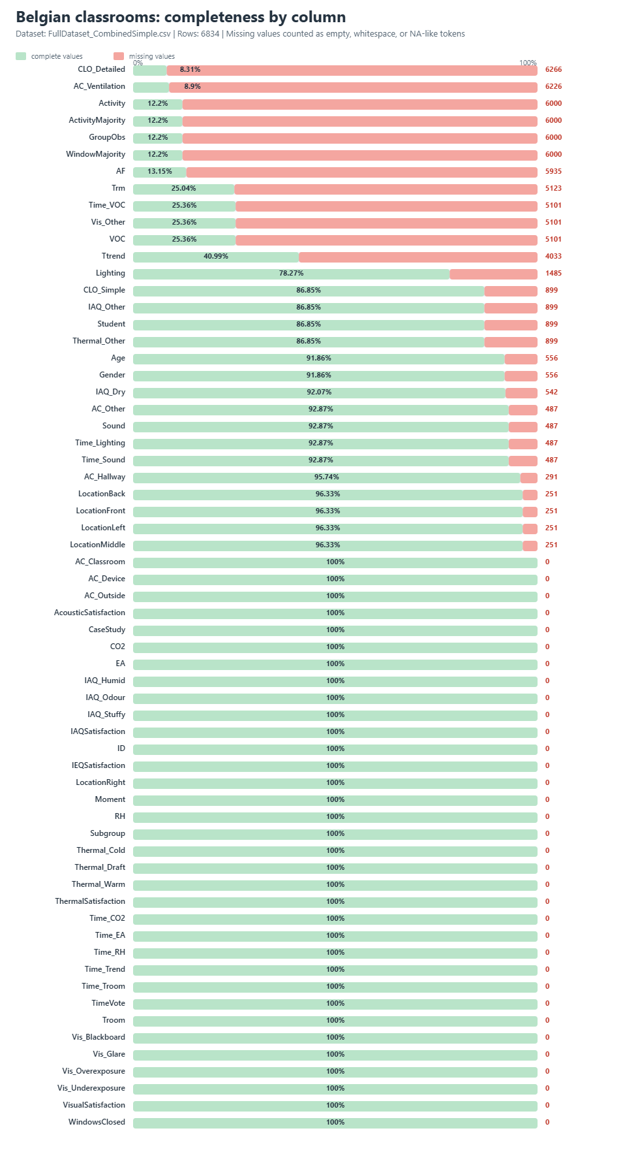
Dataset evaluation

Slide 84
Dataset evaluation

Slide 85
KEY REVIEW | SUBJECTIVE IAQ & OCC
A Review of Subjective Indoor Air Quality Assessment in Non-Residential Buildings: Current Trends and Recommendations
Carton, Al-Assaad, Kolarik & Breesch | Buildings 2026 | systematic review | field studies only
Summary
RESESRCH GAPS THAT I CAN FILL
2026 review from authors of Belgian classroom dataset.
Analyzed 46 papers about IAQ
Lack of IEQ prediction models
Lack of personalization → I plann to compare general and personalized models
Lack of repeated measurements on thesame person (Belgian clasroom dataset has these data)
Lack of models that could be used for personalized HVAC operation
MAIN FINDINGS
NOTES
The literature is fragmented: scales, survey wording and analysis choices vary too much for meta-analysis.
Associations are not explained by IEQ alone; personal and contextual variables repeatedly matter.
Many studies analyse only 1–4 variables; 63% restrict analysis to just one variable category.
Methodological validity is often weak: poor justification of statistical method and almost no power analysis.
Only 3 of 46 studies did predictive models
The best, newest and most related review I have found so far.
My research exactly fill some of the research gaps.

Slide 86
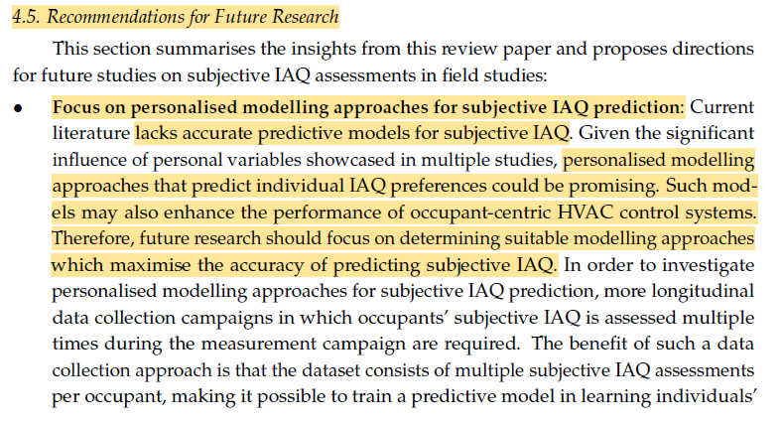
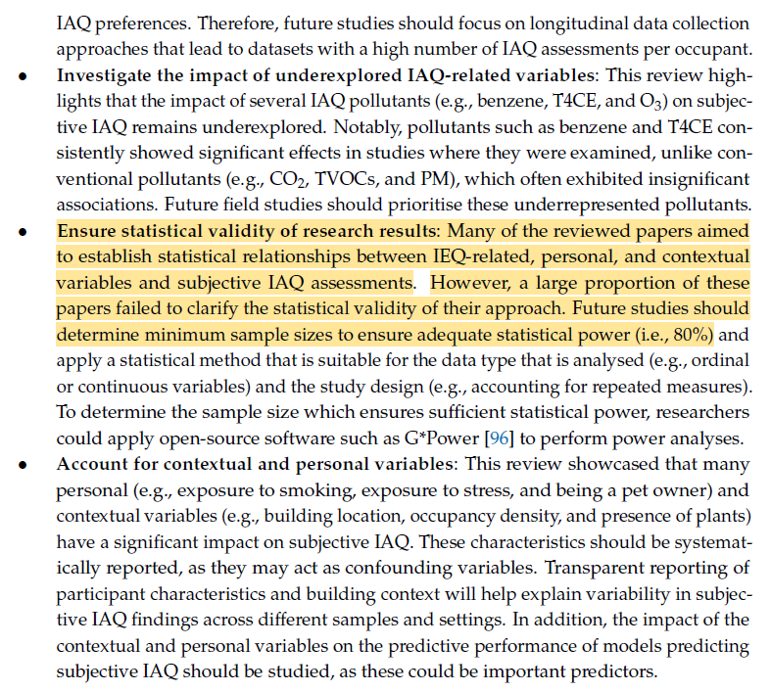

Slide 87


Slide 88
Dataset related papers
Retated papers
Primary school: 3 citations
A Review of Subjective Indoor Air Quality Assessment in Non-Residential Buildings: Current Trends and Recommendations
Approaches to Assessing IEQ in Urban School Classrooms: Focusing on Primary and Secondary Education
Supportiv document for IEQ in schools (does not talk about models)
Secondary schools: 3 citations
Indoor environmental quality for comfort learning environments: case study of Palestinian school buildings
Dataset is not public
Evaluation of indoor environmental quality and pupils' satisfaction in Flemish primary schools
Part of the full dataset
Occupant-centric control in non-residential buildings
Conference abstract (They proposed to study: relationship between IEQ and satisfaction, develop personalized satisfaction models, integrate them into an HVAC-based occupant-centric control framework, and define a consensus strategy for shared spaces such as classrooms and open-plan offices.)
Lecture rooms: 7 citations
Predicting individual thermal preferences in an office: Assessing the performance of mixed-effects models
Only thermal preference; they have proved that mixed-effects models improve accuracy
Analyzing the Impact of Occupancy Patterns on Indoor Air Quality in University Classrooms Using a Real-Time Monitoring System.
Full dataset: 0 citations

Slide 89
Similar papers to ours
Retated papers
Predicting the student’s perceptions of multi-domain environmental factors in a Norwegian school building: Machine learning approach
1437 responses → ML multi-domain IEQ prediction → The best was Random Forest with R² = 0,91 and accuracy > 80 % → shows that even 1/3 of our data was enough to train a model.
This paper is direct competitor, but stil leaves unfilled gaps:
Sample is smaller
Does not contain accustics
Does not compare generalized vs personalized models
Does not compare hierarchical vs direct models
Authors state: “Data will be made available on request.” → can be combined with our dataset
Machine Learning Prediction of Student Satisfaction on Indoor Air Quality and Thermal Environment in a Norwegian Secondary School
1473 responses → ML prediction of dissatisfaction with IAQ and thermal → accuracy > 80% → SHAP used for interpretation.
This paper is a competitor, but it still leaves unfilled gaps:
covers only 2 domains (IAQ + thermal)
does not compare generalized vs personalized models,
does not compare hierarchical vs direct models,
no openly downloadable dataset is visible from the record, unlike your Belgian classroom line.

Slide 90
Similar papers to ours
Retated papers
Assessing the perception of overall indoor environmental quality: Model validation and interpretation
1869 responses → overall IEQ satisfaction prediction from 4 domain satisfactions → regression + ML + external validation on a second dataset → prediction error increased by 21% when generalized to a new dataset → one unsatisfying factor often dominates overall IEQ.
This paper is a very direct competitor, but it still leaves unfilled gaps:
does not use a classroom data (previous research has proven that models are not well transferable from non-shool environment to schools)
does not compare generalized vs personalized models
does not compare hierarchical vs direct deployable models
models overall satisfaction from domain satisfactions, not from the full classroom sensor/context pipeline
does not benchmark unseen occupants vs unseen classrooms the way you propose.
Quinten Carton – Personalised occupant satisfaction models for HVAC control in educational buildings (2025)
Belgian classrooms dataset → personalised mixed-effects (ME) models for thermal and IAQ → personalized models are better → 10 occupant feedback votes may be enough → simple ME models using only room temperature performed similarly to more complex models → the models were then integrated into an occupant-centric HVAC control framework and tested in simulation.
This dissertation is a strong competitor, but it still leaves key gaps unfilled:
does not model overall IEQ satisfaction as the main prediction target,
does not compare multiple ML families such as RF / XGBoost / SVM / NN,
does not compare hierarchical vs direct models,
is framed around HVAC control, not around a benchmark of overall IEQ prediction.

Slide 91
LITERATURE REVIEW
Research proposal → Word document
Searching for research gaps| Week 3

Slide 92
LITERATURE REVIEW
Do we have enough data?
Searching for research gaps| Week 3

Slide 93
Do we have enough data?
Related papers
Predicting the student’s perceptions of multi-domain environmental factors in a Norwegian school building: Machine learning approach were able to make overal IEQ (thermal IAQ, visual) prediction with more than 80% accuracy on only 1473 responses
We have 5240 responses for full IEQ

Slide 94
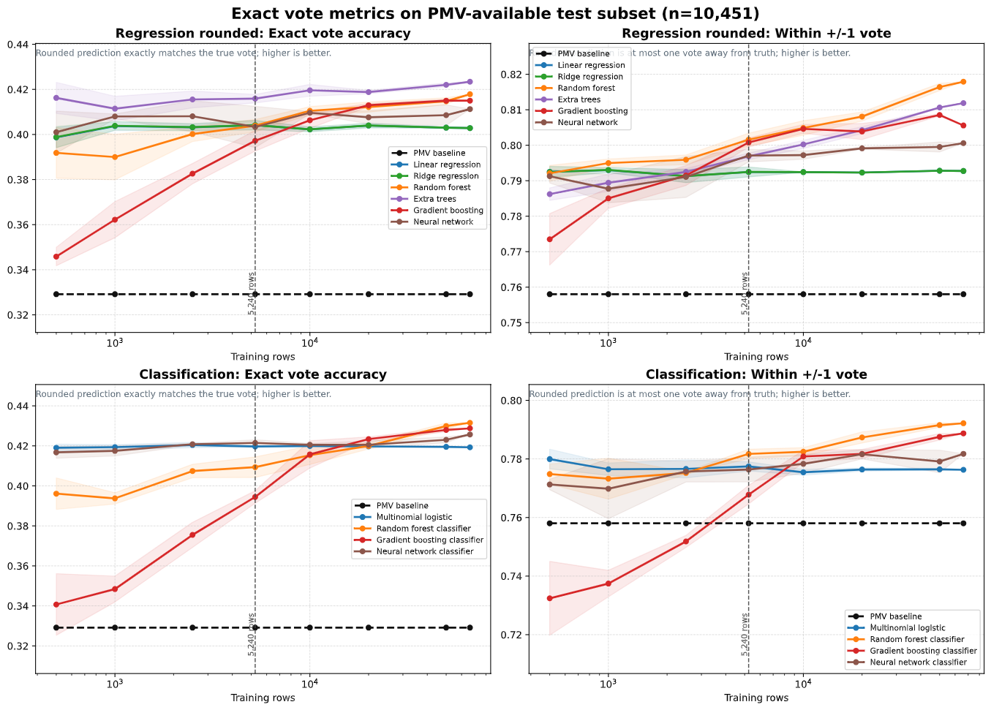

Slide 95
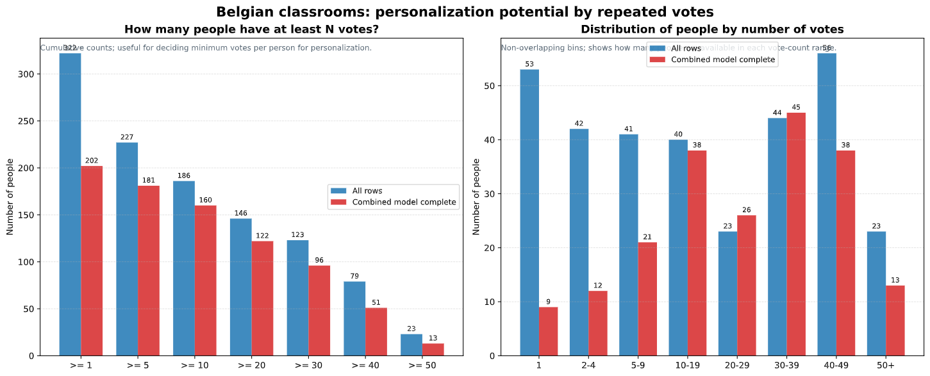
Personalization data

Slide 96
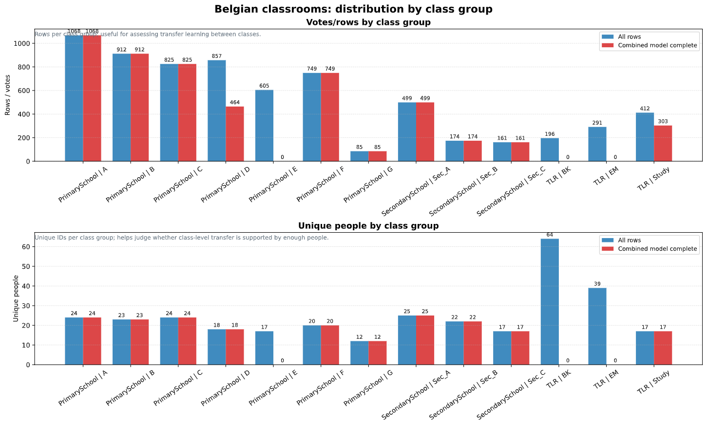
Transferability between different classrooms

Slide 97
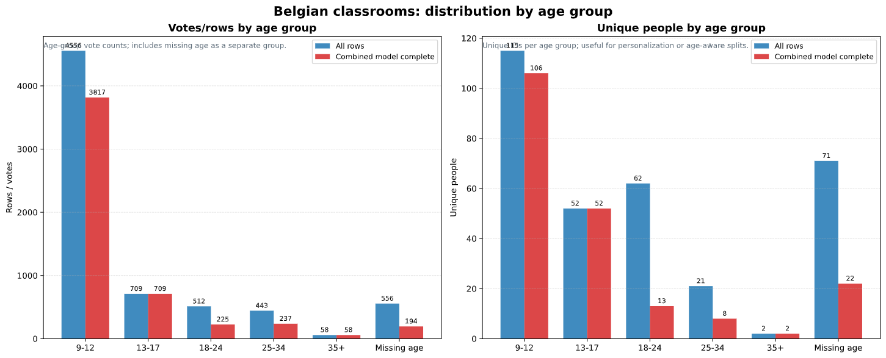
Transferability between different age groups

